Slide 1
EUROPEAN TERMINOLOGY AND ACADEMIA
“Terminology without Borders”:
a multilingual collaborative and networking project
between the European Parliament and Universities
Rodolfo Maslias, Terminology Coordination (DG TRAD)

Slide 2

Terminology without Borders
A new collaboration with universities
All the resources, descriptions and resulting multilingual glossaries the website https://yourterm.org
10 domains, 36 subprojects
more than 20 partners
active and expanding collaborations in 3 continents (Europe, Asia and North America)

Slide 3
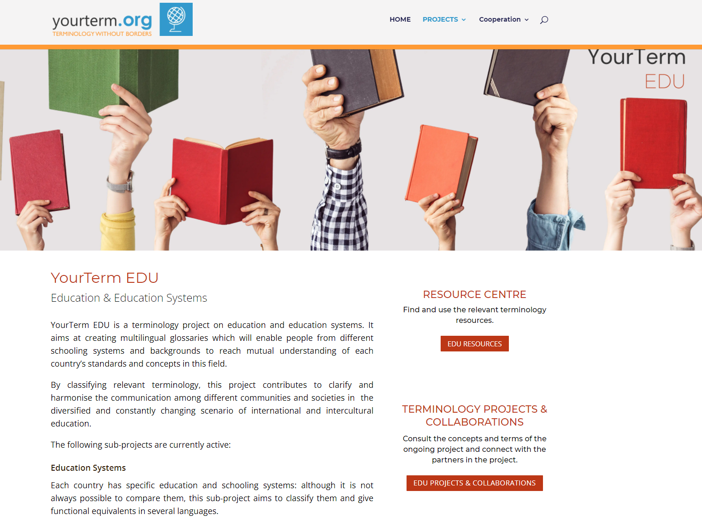
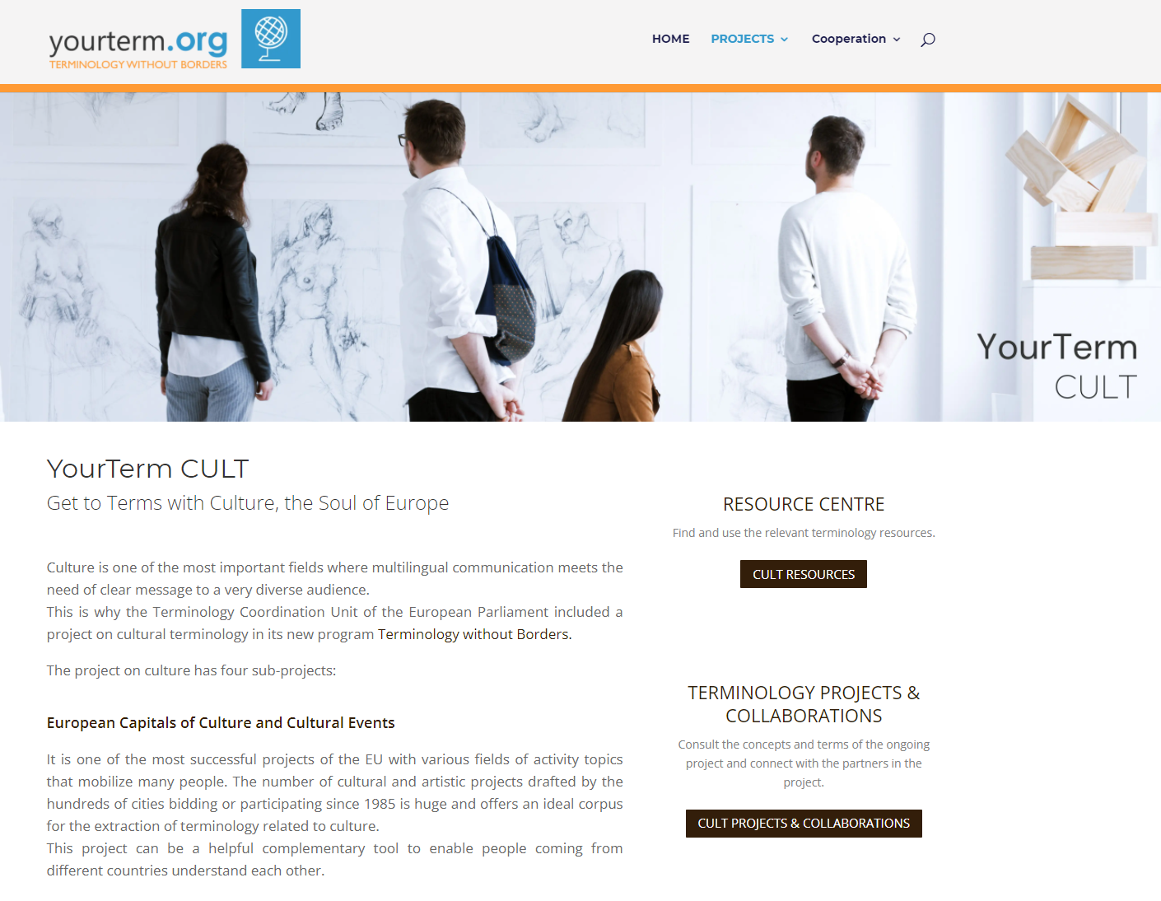
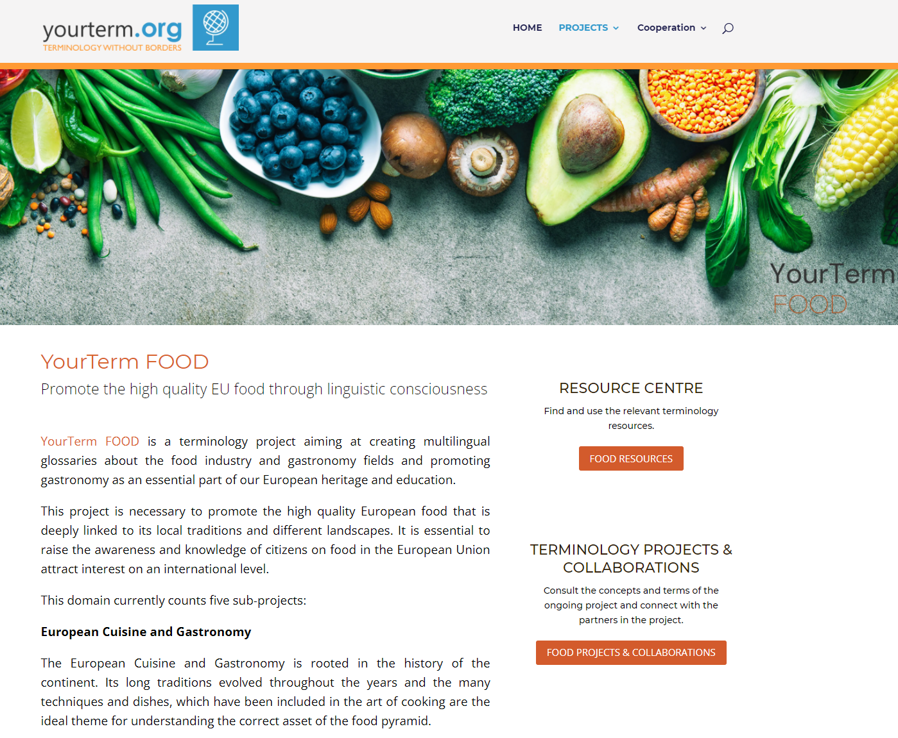
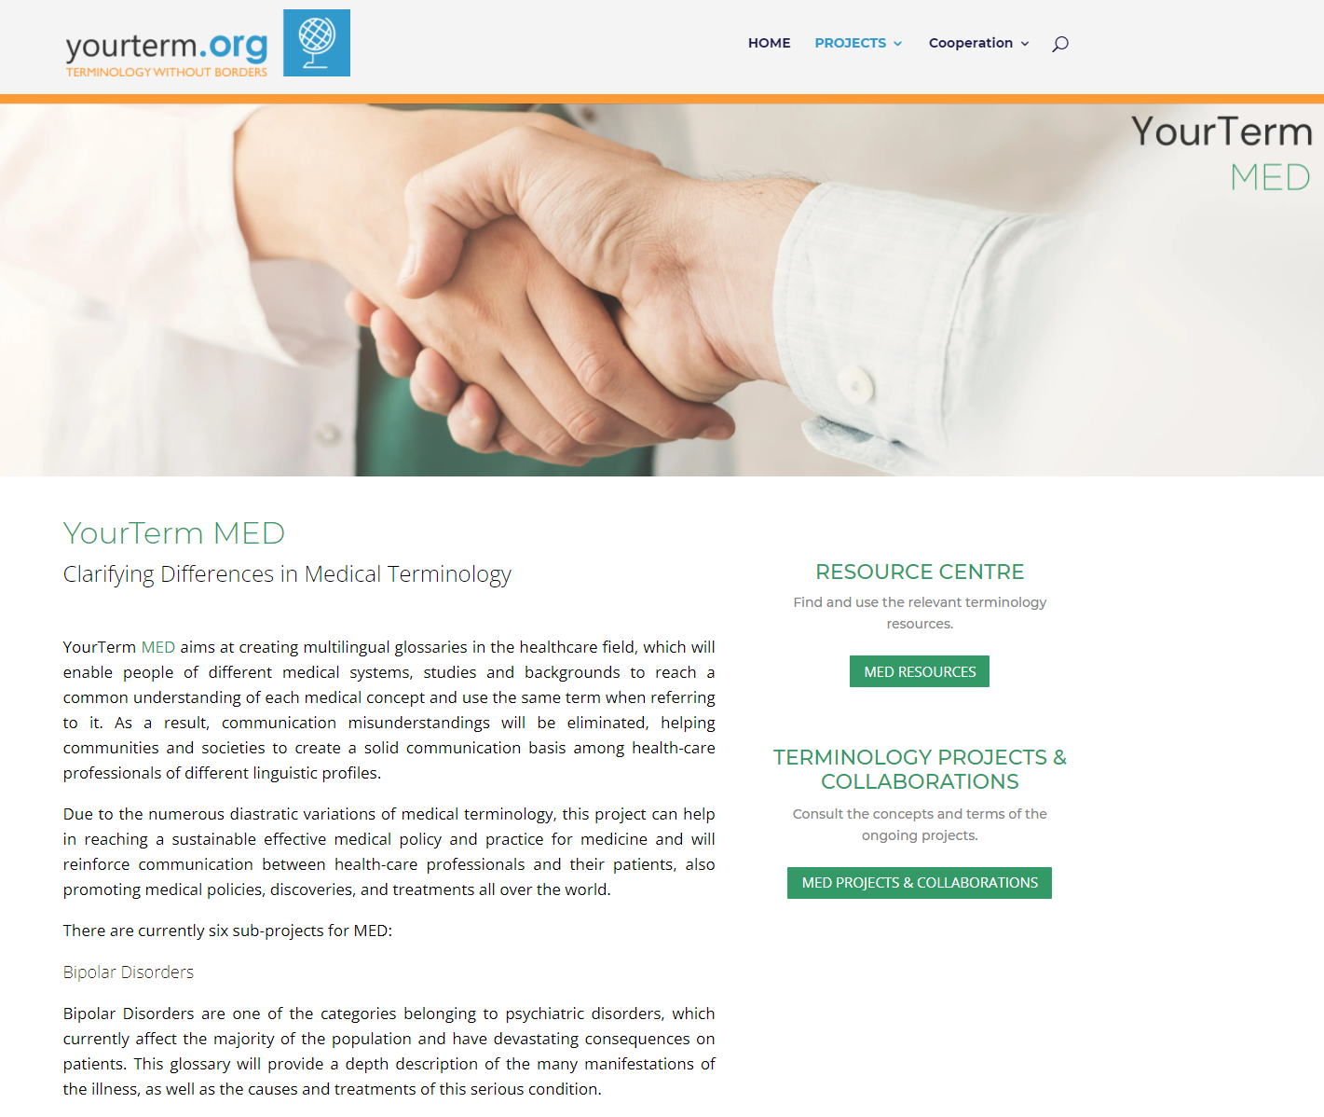
YourTermProjects

Slide 4

The workflow of the projects
Creation a corpus of relevant texts
Term extraction to create a glossary in any source language
Adding equivalents in several languages
Validation by experts
Publication in the website
Validation of the terms by the terminologists of the European Parliament and insertion as collections into IATE
Each university department decides which parts of the workflow it wants to use, since this project has mainly an educative objective.

Slide 5
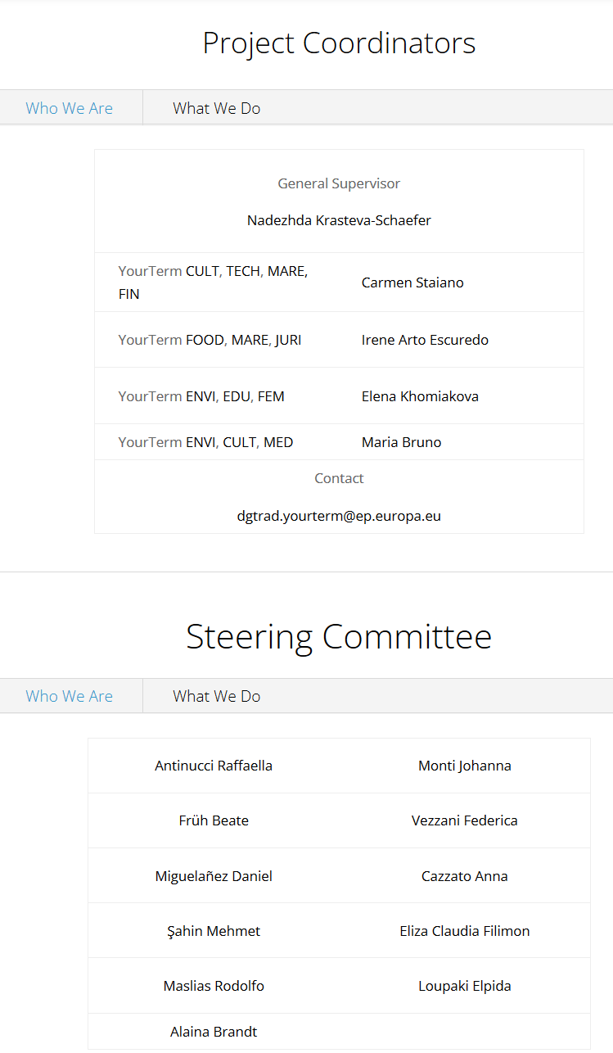
Coordination of the project
The project is coordinated by
permanent staff members and trainees of TermCoord, specialised in terminology and communication
with the assistance of a steering committee made by participating Professors
Regular remote meetings, a permanent online communication via a functional mailbox and a “Confluence” collaborative platform and forum to enable the constant cooperation and networking between the partners

Slide 6
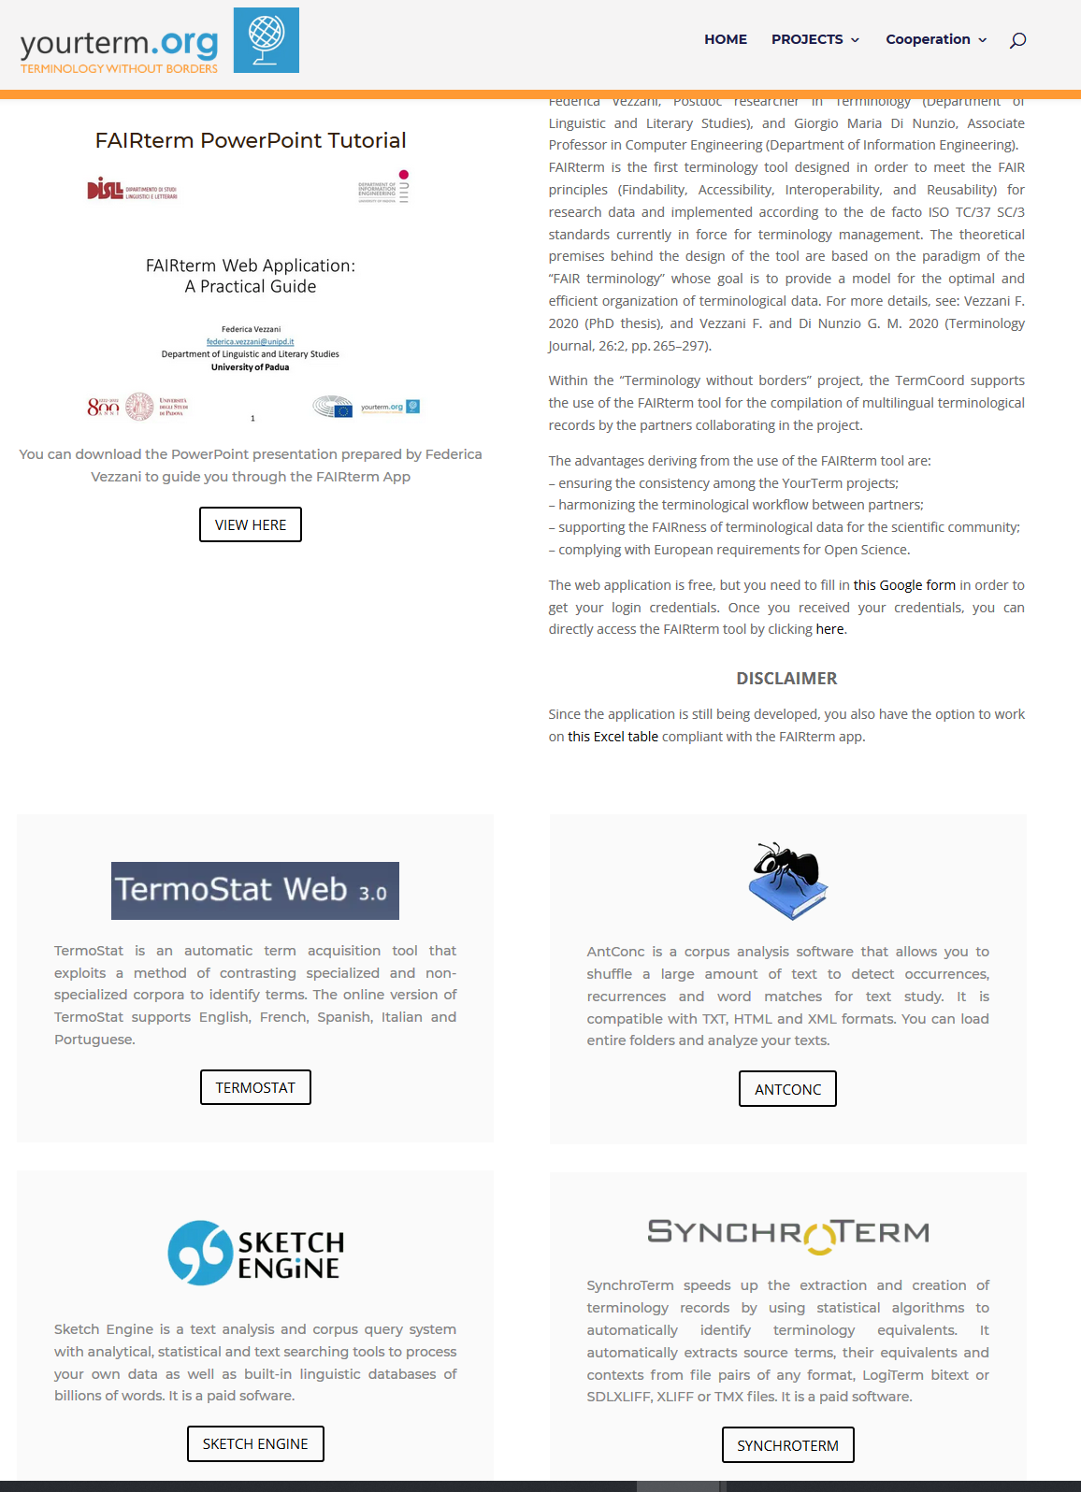
The Toolbox
TermCoord suggests and presents in the website some tools to be used by the participants and among them the
application FAIRterm created by the University of Padoua with the aim to align the produced multilingual glossaries

Slide 7

Universities suggest subprojects in their field
Example: YourTerm CULT: 1) European Capital of Culture and Cultural Events Terminology, 2) Museums and Cultural Institutions 3) House of European History 4) Archaeology

Slide 8
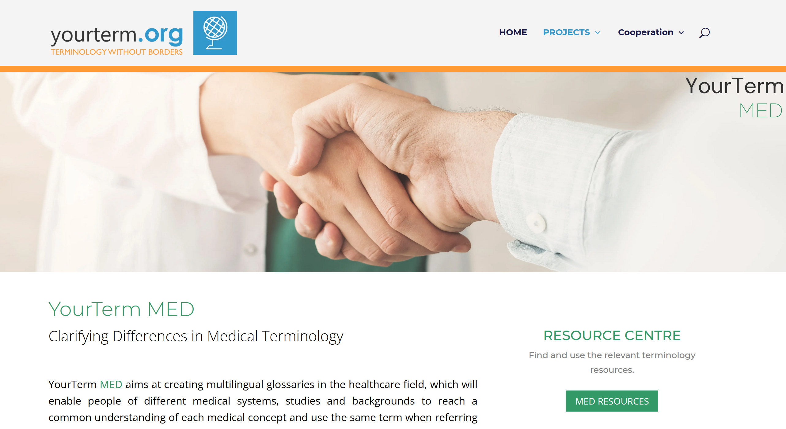
Section 1: The Resource Centre:

Slide 9
Terminology Resources – example: YourTerm MED
In every project there is a collection of relevant resources to be used by the participants for the elaboration of their project, but also made accessible to the wide public accessing the website
Glossaries
Cochrane Glossary (EN)
Dictionnaire médical de l’Académie de Médecine – ver 2020 (FR) Académie nationale de Médecine
Drugs@FDA Glossary of Terms (EN), U.S. Food&Drug Administration
Glossaire des sigles (FR) Hôpitaux de Toulouse
Lexique des mots alternatifs (FR, terme médical-mot familier) Santé Montréal
Lexique des termes médicaux (FR) Hôpitaux Universitaires Genève
OncoTerm (EN, ES) LexiCon
Organ donation glossary (DE) University of Heidelberg, Germany
........

Slide 10
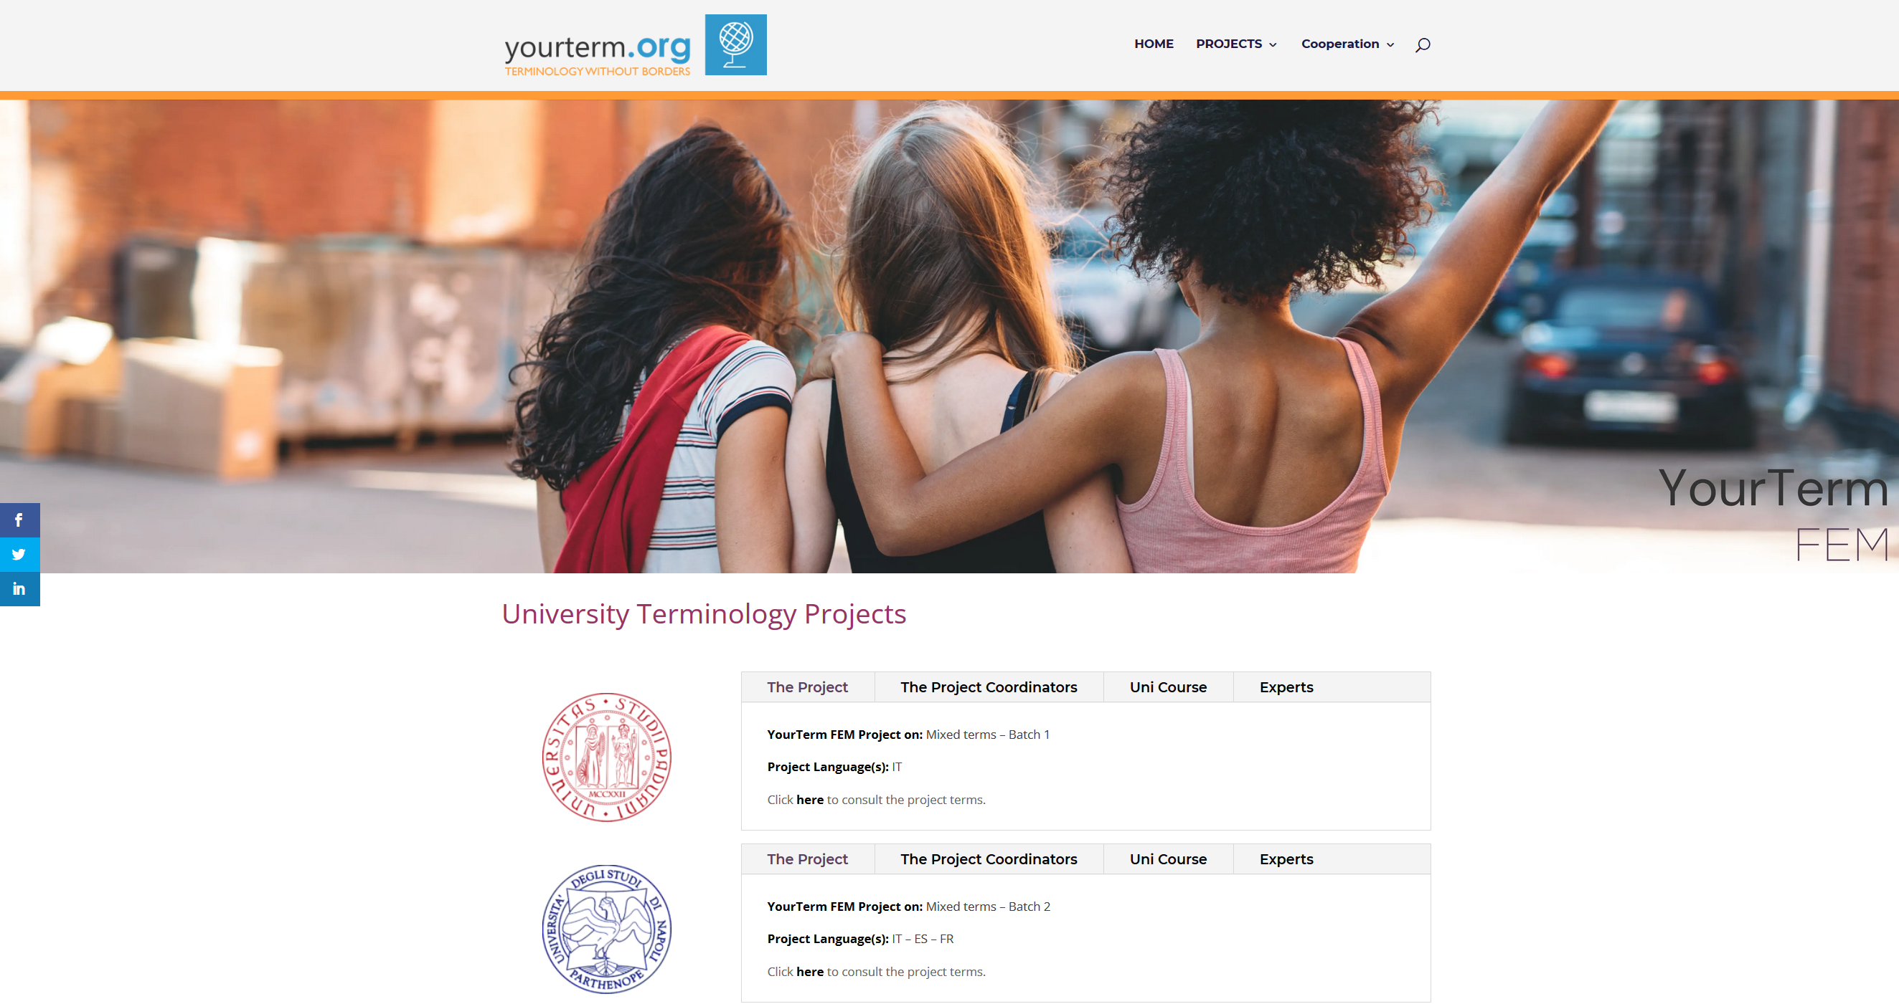
Section 2: Collaboration
A short description of the project, logo of the University
Bio of the Professor,
names of the
participating
students

Slide 11
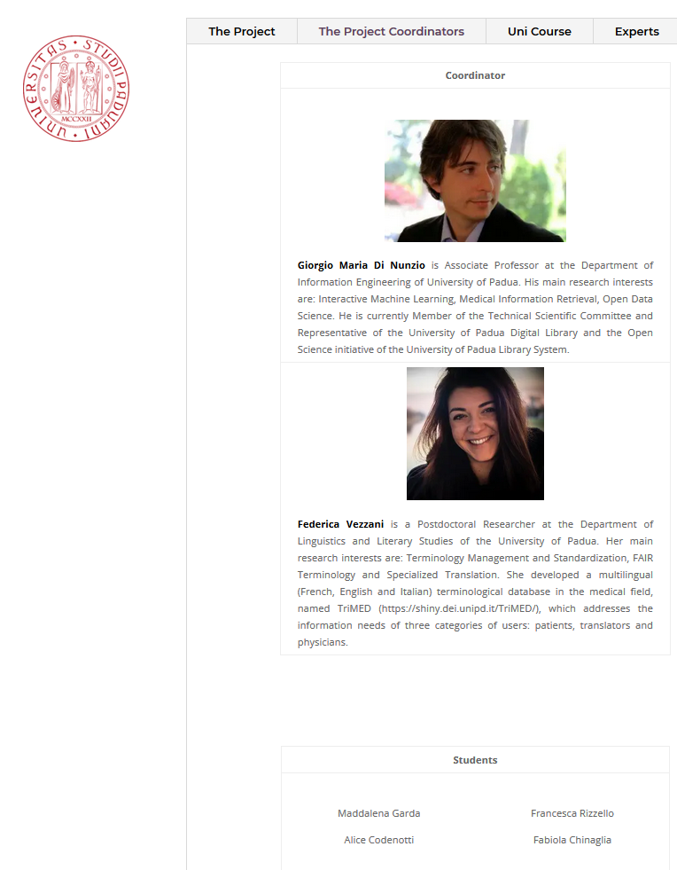
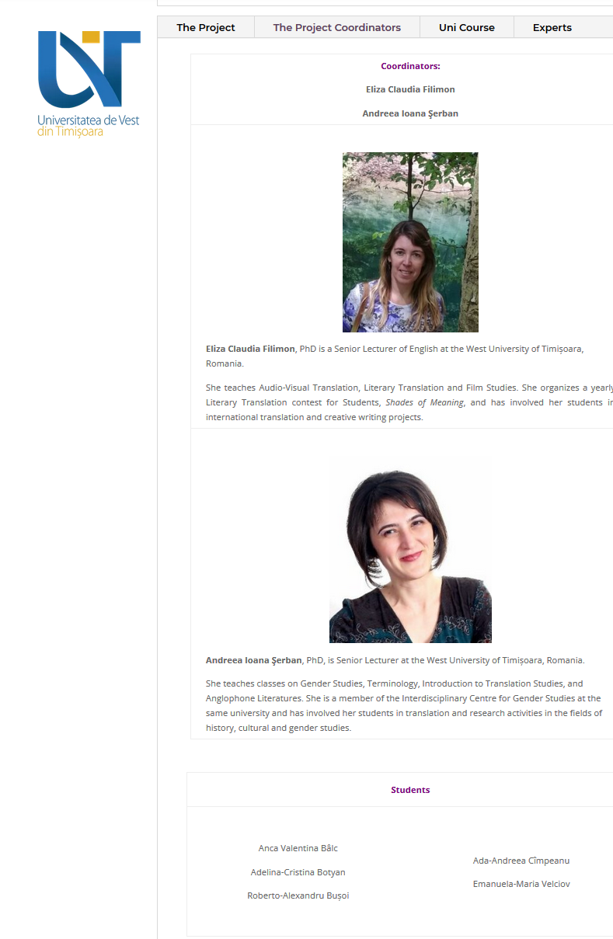
Section 2: Collaboration

Slide 12
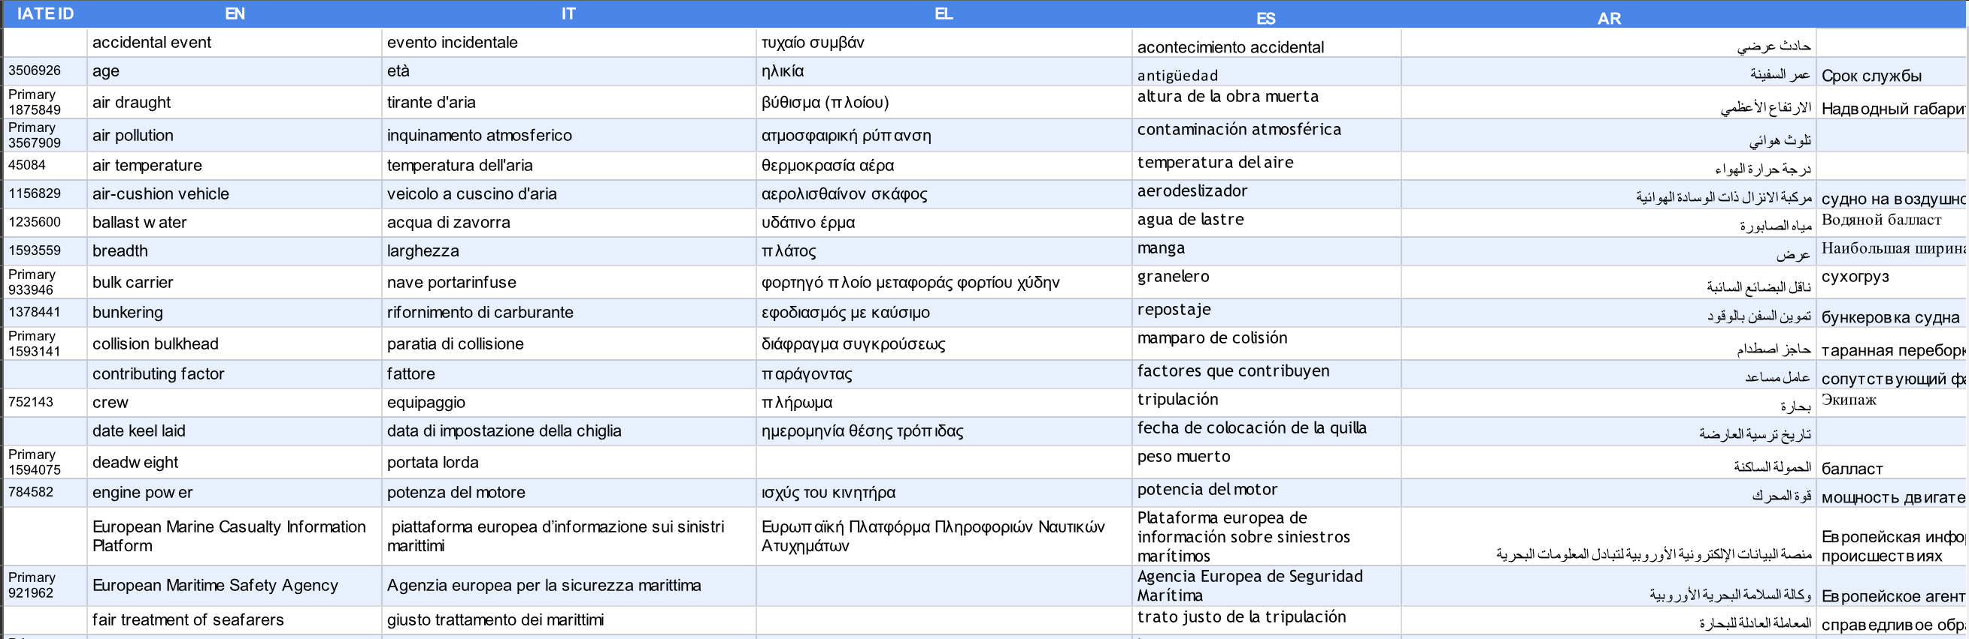
Section 3: the terminology
The terminology tables produced by the Universities and revised by experts are published on the website and complete gradually the multilingual glossary. They are also inserted into IATE as separate collections
Example: Project MARE, Subproject Maritime Safety and Ship Construction

Slide 13
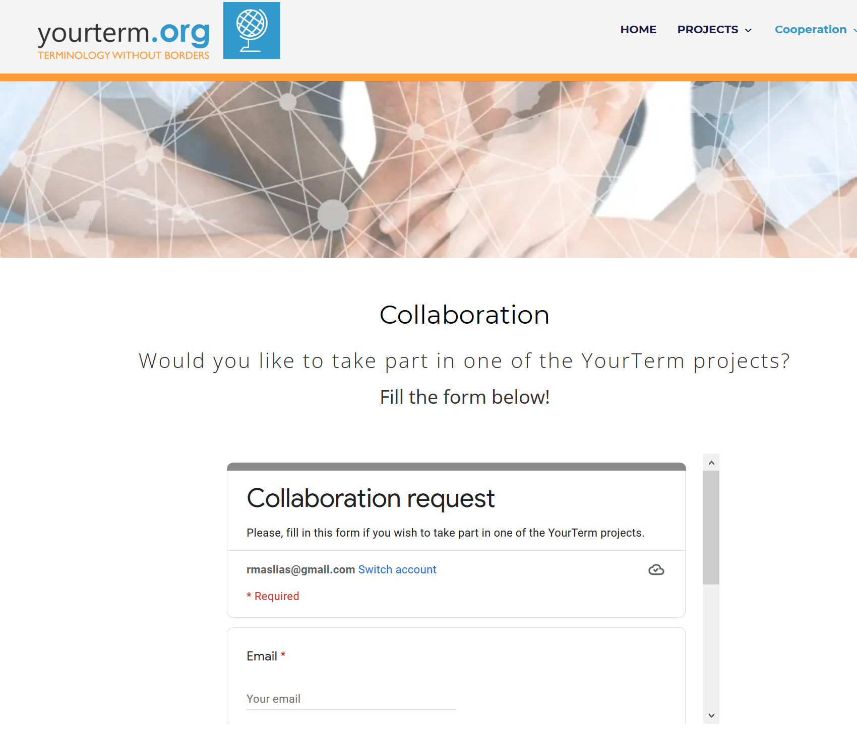
The way to apply

Slide 14
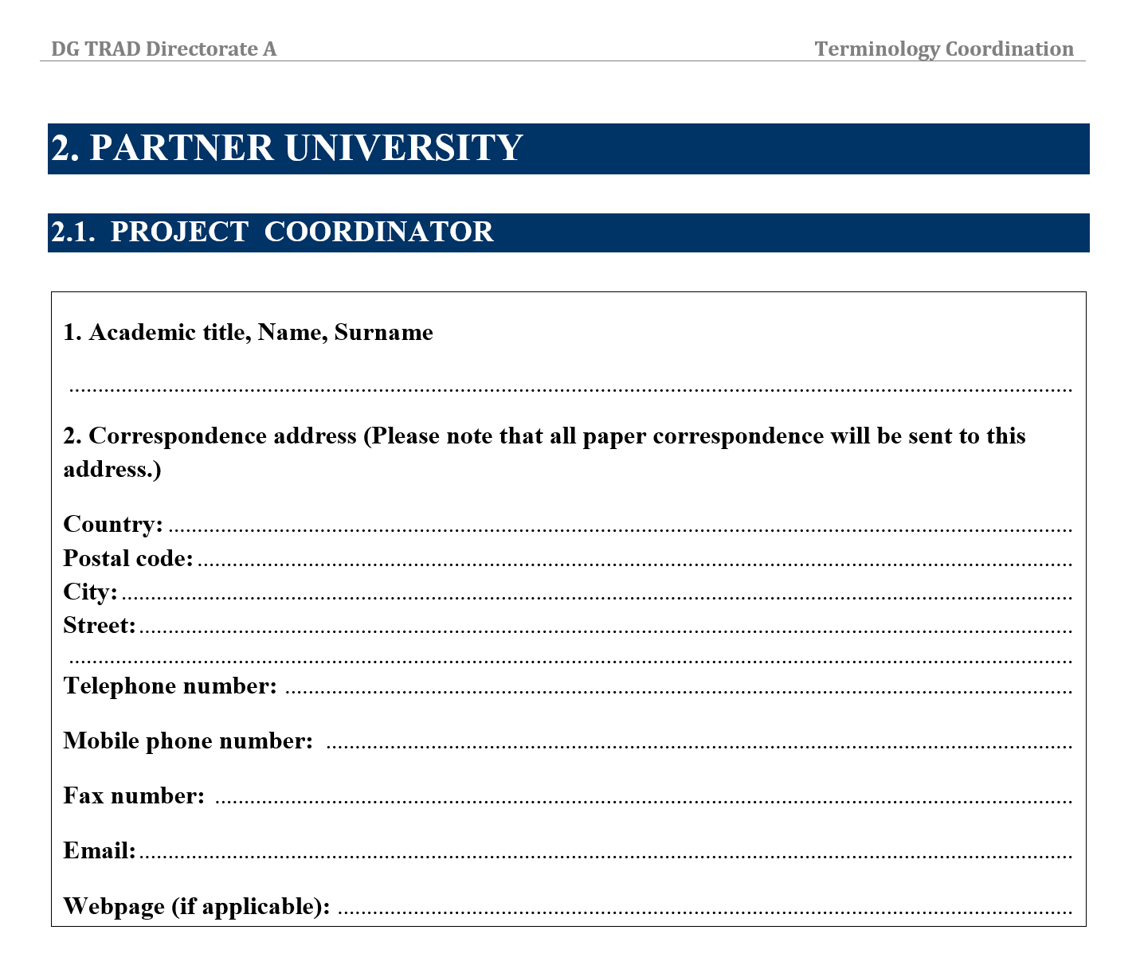
The Agreement with TermCoord
An online form of an agreement is available for the partners, but TermCoord is willing to sign any form required by the Universities

Slide 15
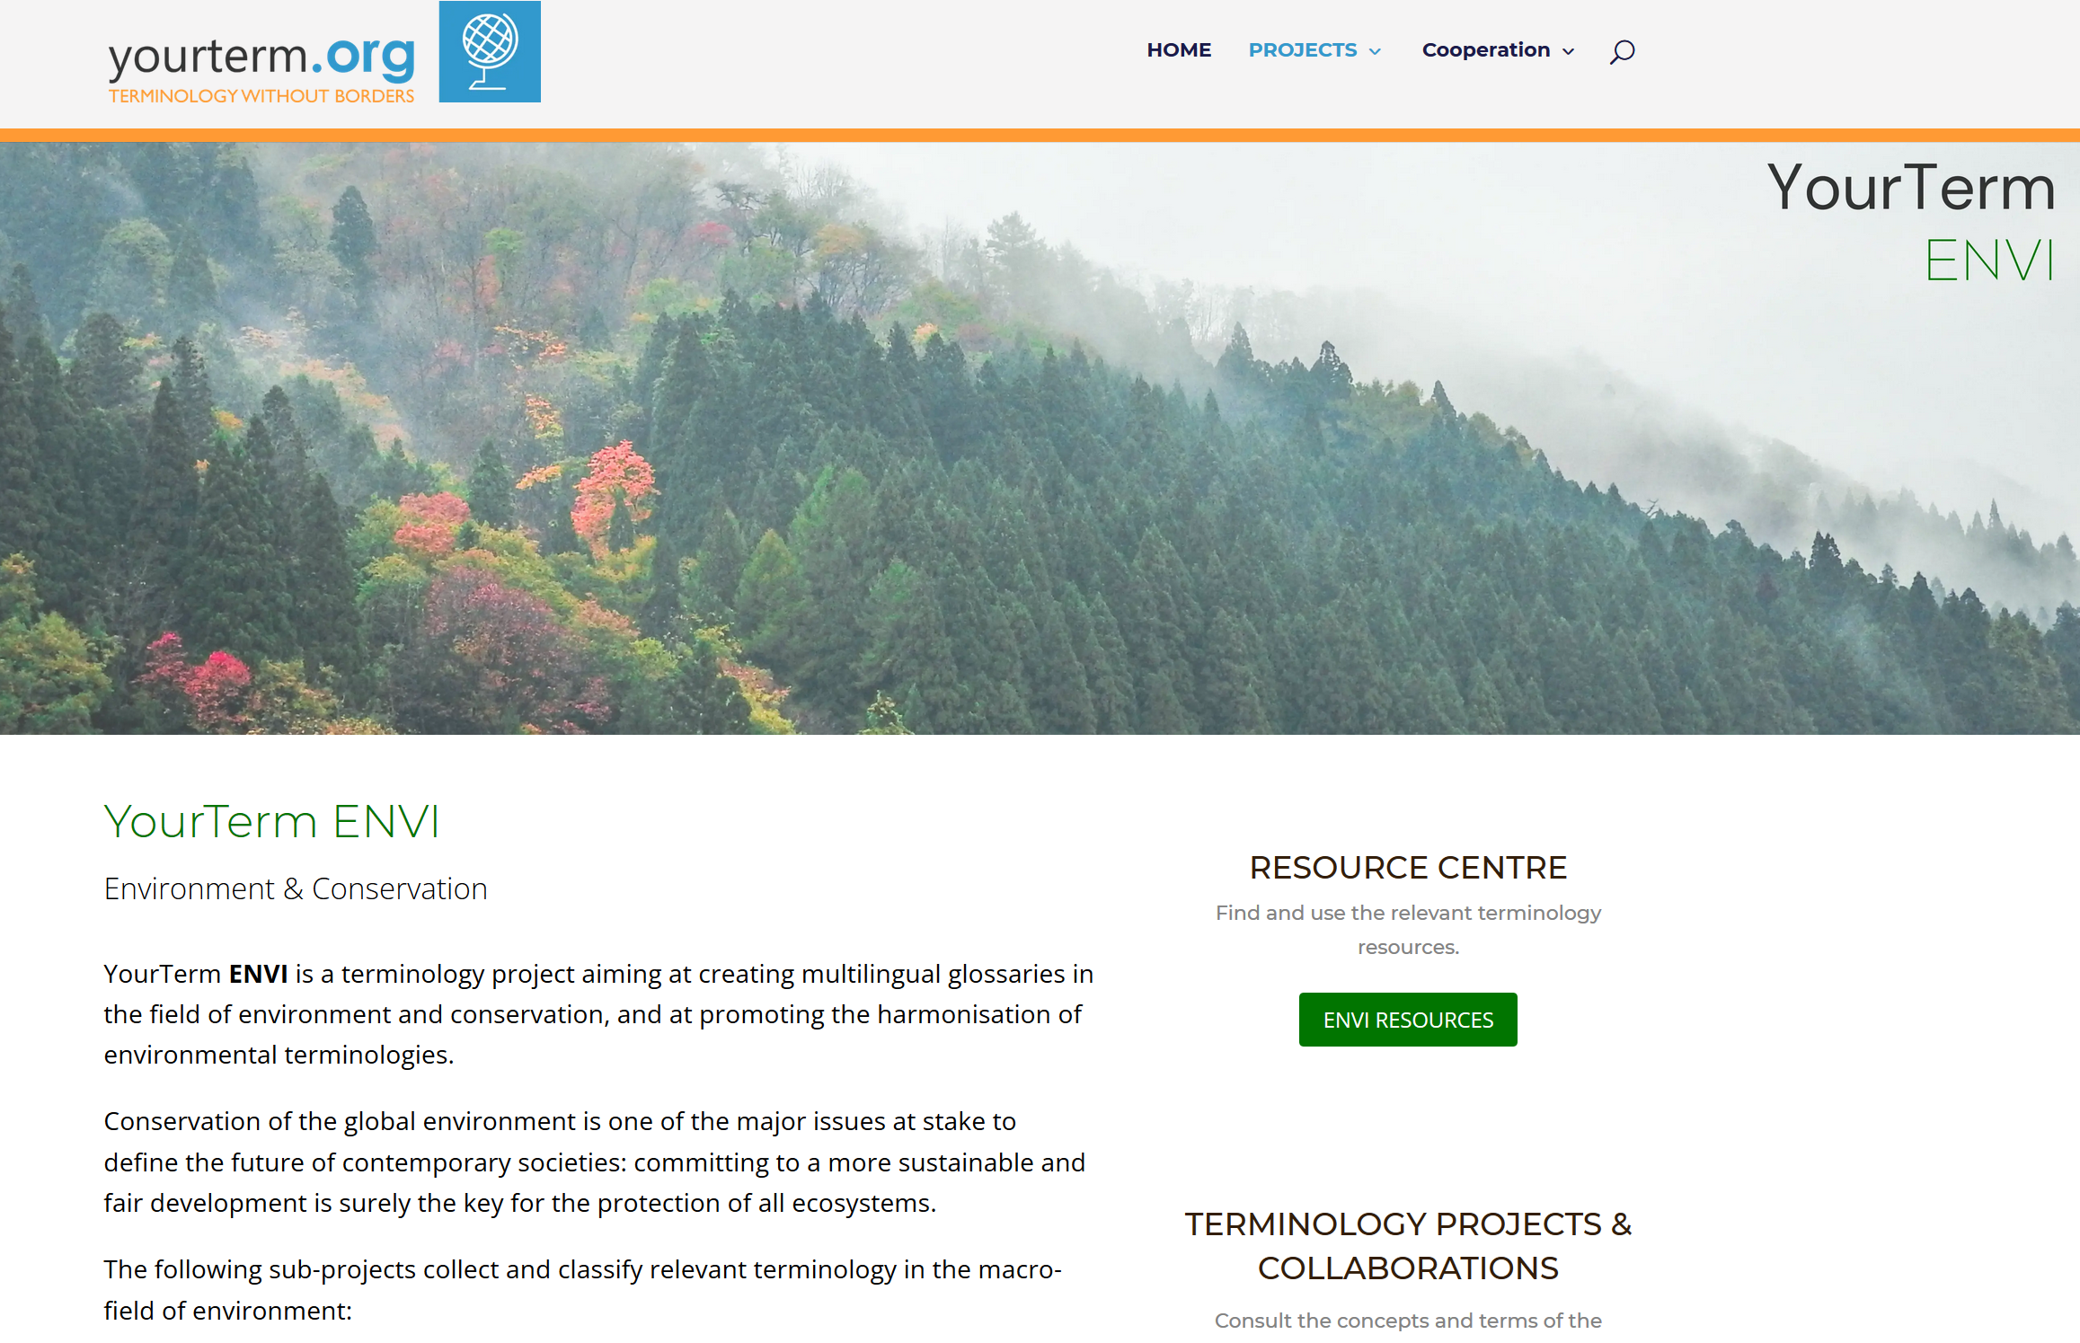

Slide 16
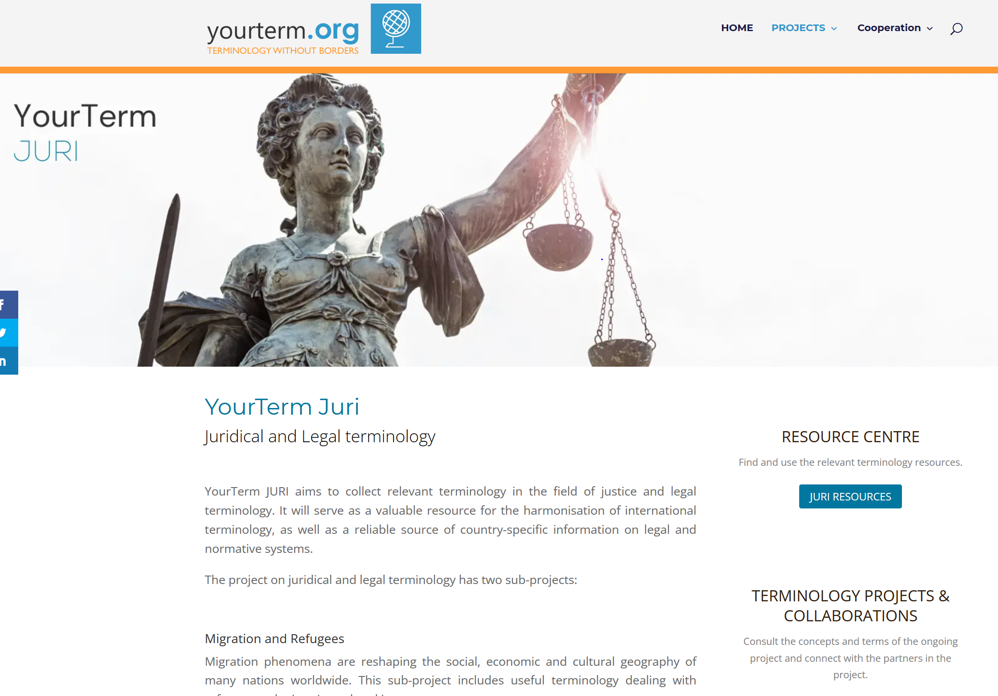

Slide 17


Slide 18
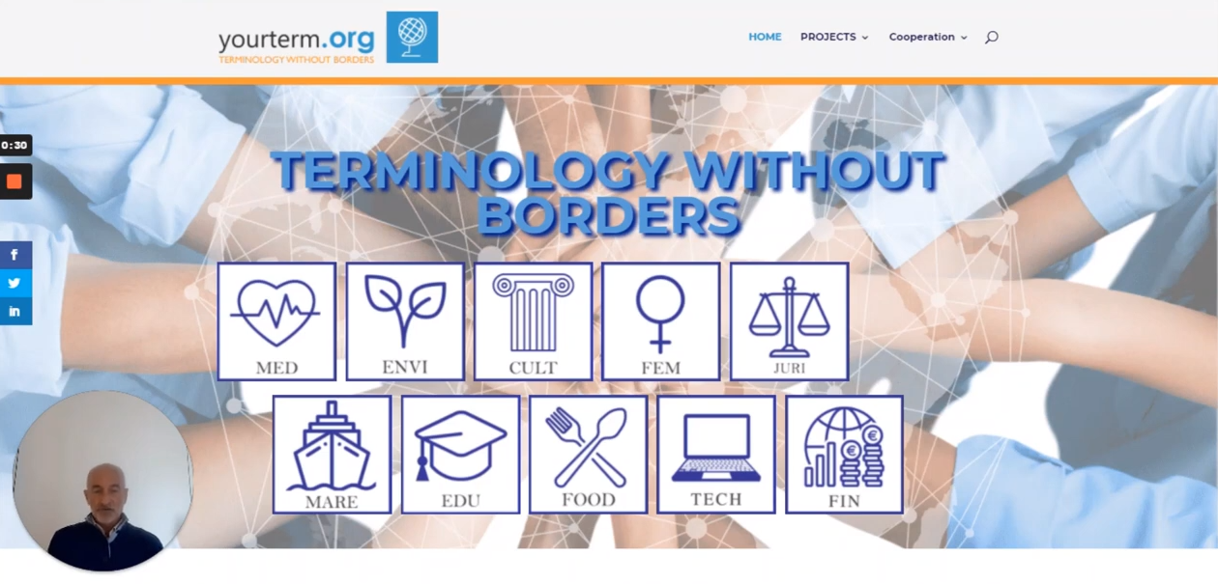
Watch a short video on the project and the workflow

