Slide 1
EU Terminology goes TECH
Rodolfo Maslias & Nadezhda Krasteva-Schaefer
TermCoord, European Parliament

Slide 2
Terminology management in the EU and the EP
IATE – what is new (search, collections, domains, download of termbases)
Terminology without Borders (cooperation with universities)

Slide 3
27 COUNTRIES
24 LANGUAGES
one law
The European Union is the largest union of states, with a common body of legislation which is applied in numerous areas of life.
EU legislation is transposed into national law and applied in the official language of each country.
In some domains, up to 80% of the laws of the Member States are based on European legal acts.

Slide 4
Regulation N°1/1958
The official languages and the working languages of the institutions of the Union shall be Bulgarian, Czech, Danish, Dutch, English, Estonian, Finnish, French, German, Greek, Hungarian, Irish, Italian, Latvian, Lithuanian, Maltese, Polish, Portuguese, Romanian, Slovak, Slovenian, Spanish and Swedish.
Notes:
06/10/2021 19:58
4

Slide 5
EU: the multilingual train
Notes:
5

Slide 6
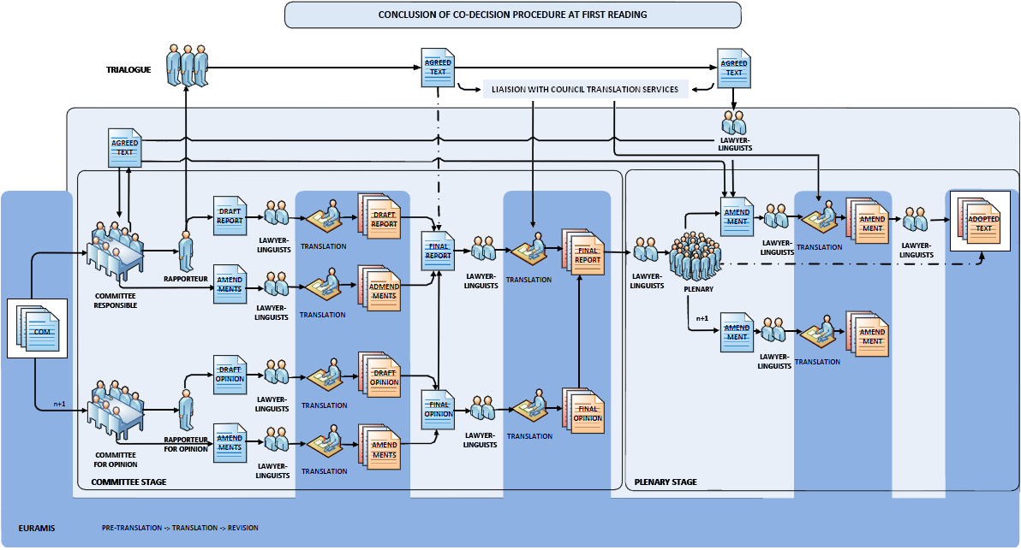
The Way Through TRANSLATION
Translation is present at every step in the legislative process; from the first draft, which originates with the Commission’s experts, through all the negotiations with national departments and with the Council and Parliament, to the ultimate legal act, on which a vote is taken in each national Parliament, and which then becomes an ‘original law’.

Slide 7
The biggest Human Linguistic Machine
Translation and Interpretation in the EU Institutions
10 Institutions
5000 translators
250 full-time terminologists
Involvement of translation and interpretation in the legislative process: draft, negotiations, co-decisions, amendments….

Slide 8
Terminology and technological progress
Ontology and semantic web
Quality assurance in CAT tools and MT
Normative terminology for proactive use
Terminology resources for post-editing
Terminology and artificial intelligence – bioethics
Technical aspects – Term extraction etc.
Interlinking of terminology – Cloud technology and Metasearch

Slide 9
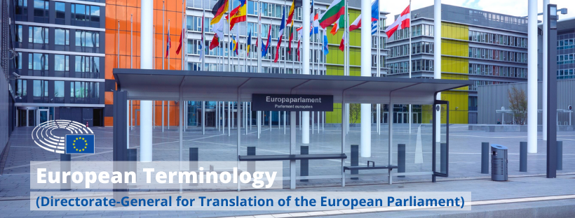
Terminology in the European Parliament

Slide 10
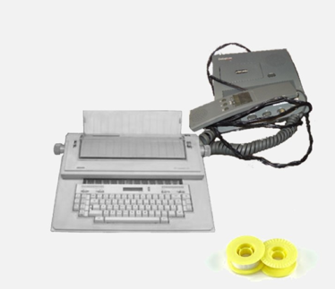
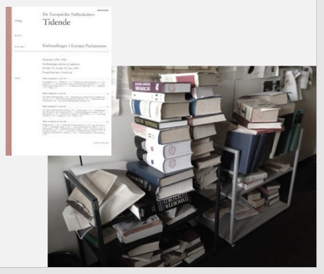
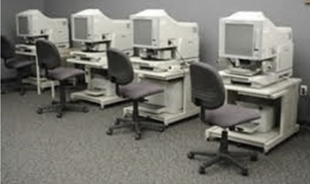
The History of Translation and Terminology in the EU Institutions
The typewriter, the correcting tape and the dictaphone
The Terminology…
database
The resources for translation and terminology – dictionaries and printed glossaries
The first training
rooms with computers

Slide 11
DIRECTORATE-GENERAL FOR TRANSLATION
Multilingualism and
External Relations Unit
Director-General
Quality Coordination Unit
Strategy and Innovation Unit
DIRECTORATE A
DIRECTORATE B
DIRECTORATE C
DIRECTORATE D
Applications and IT Systems Development
Planning Unit
Financial Resources
Management & Controls
Clear Language
and Editing Unit
Audio and Podcast Unit
External Translation
24 Language Units
BG CS DA DE
EL EN ET ES
FI FR GA HR
HU IT LT LV
MT NL PL PT
RO SK SL SV
Human Resources Unit
Speech-to-text Unit
Euramis
Pre-Translation
Training and Traineeships Unit
Subtitling and
Voice-over Unit
Terminology Coordination
IT and IT Support Unit
MHOEH Unit

Slide 12
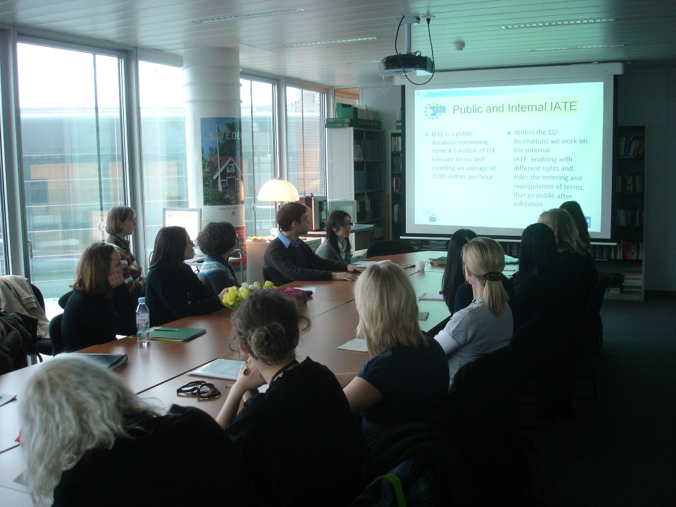
Terminology work in the central coordination
10 permanent staff posts
terminology trainees
communication trainees
rotating terminologists (seconded translators)
Notes:
12

Slide 13
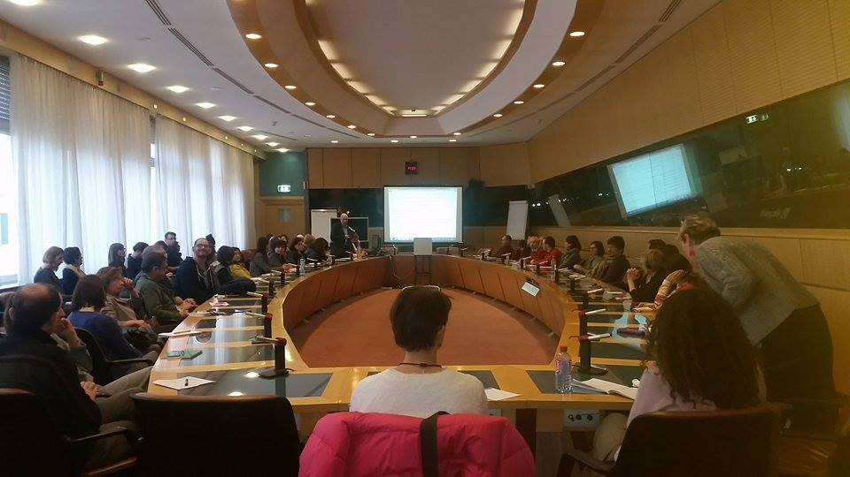
Our partners in the Language Units
“Part-time” terminologists – translators doing terminology work on the side
Minimum two terminologists per unit
Terminology Network – the network of around 120 terminologists of all the language units (meetings twice a year and cooperating online)

Slide 14
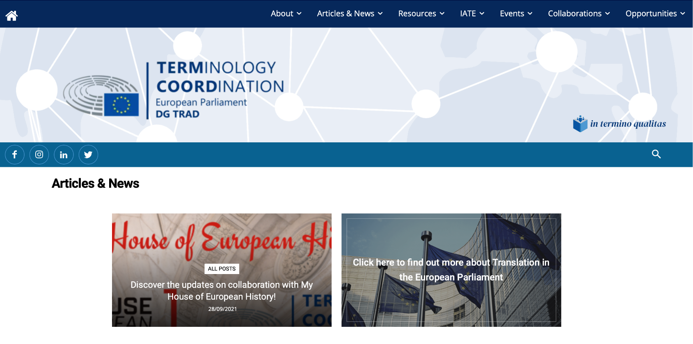
External communication
Created in 2011
Content on:
terminology
translation
interpreting
linguistics

Slide 15
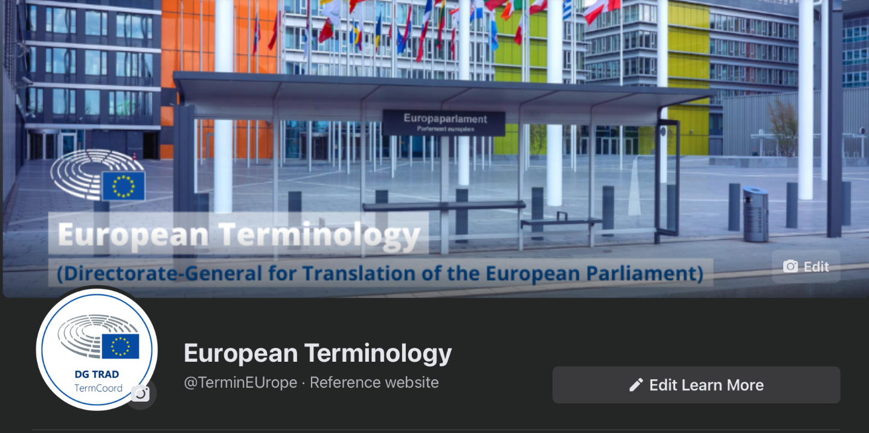
Follow, Like, Connect, Retweet, Tag TermCoord!
In a desire to make it easier for TermCoord’s community to find us on all social media, we have created a common brand. You can now find us on the following links under the same handle:
Facebook: https://www.facebook.com/TerminEUrope/
Instagram: https://www.instagram.com/termineurope/
Twitter: https://twitter.com/TerminEUrope/
LinkedIn: https://www.linkedin.com/in/terminEUrope/

Slide 16
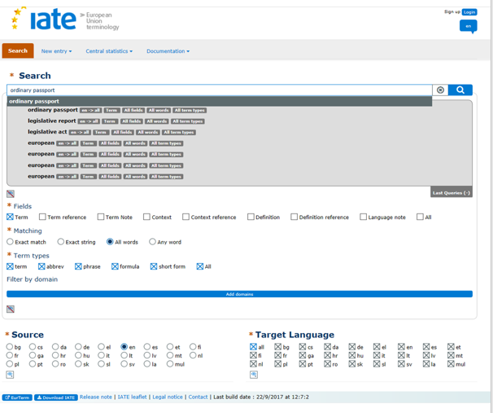
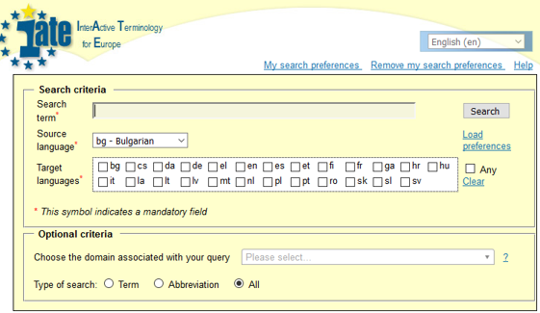
2018: The New IATE
interinstitutional terminological database of the EU Institutions;
created in 2002, new version released in 2018;
terms in the 24 EU languages;
fusion of digital databases like Eurodicautom (Commission) and Euterpe (Parliament);
managed by 10 EU Institutions;
it is public and its content can be used for free;
21 domains and hundreds of subdomains based on EuroVoc domains

Slide 17
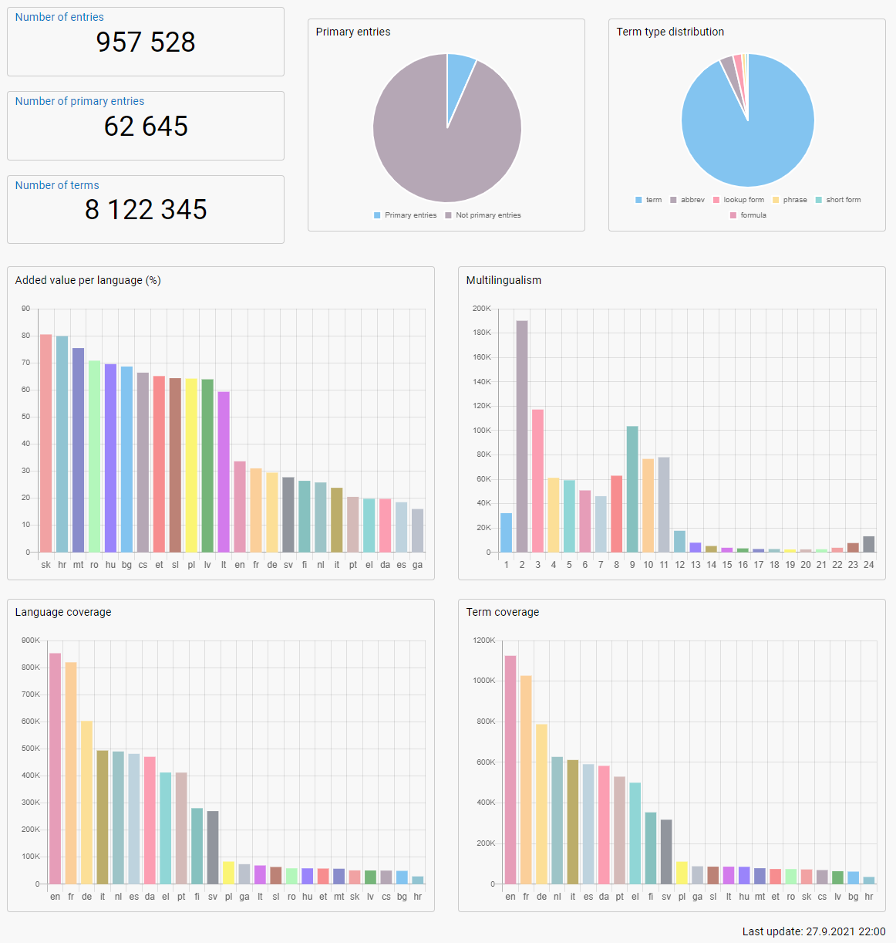
IATE statistics
The most recent statistics about IATE:
+8 million terms
nearly 1 million entries
average of 1 million searches per week

Slide 18
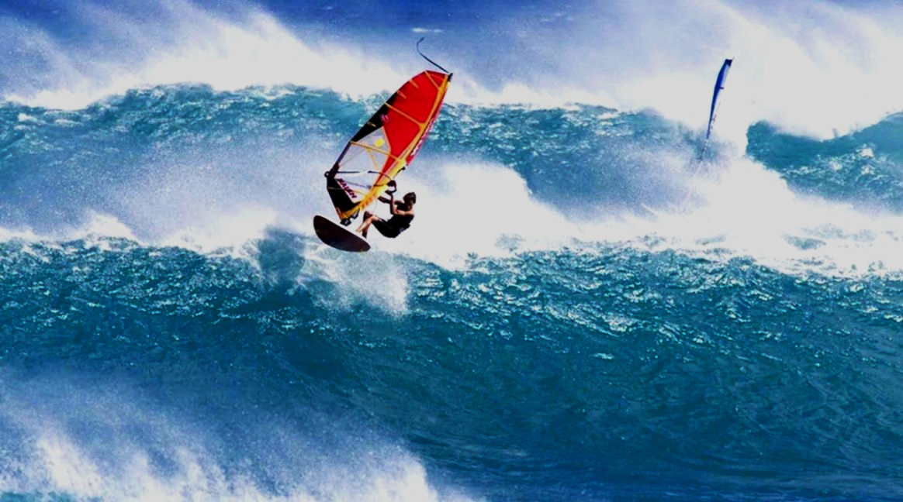
Let’s surf in IATE!

Slide 19
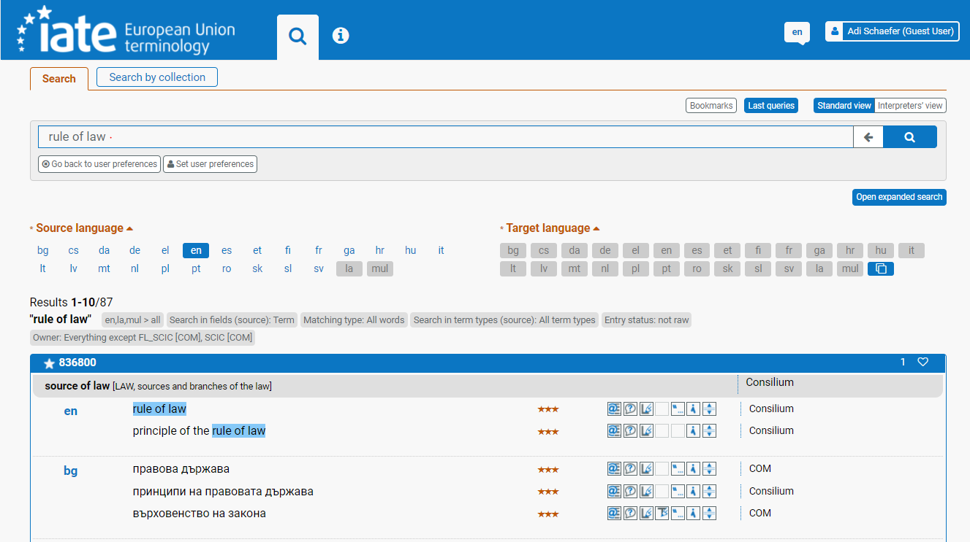
The New IATE – Search
Simple search

Slide 20
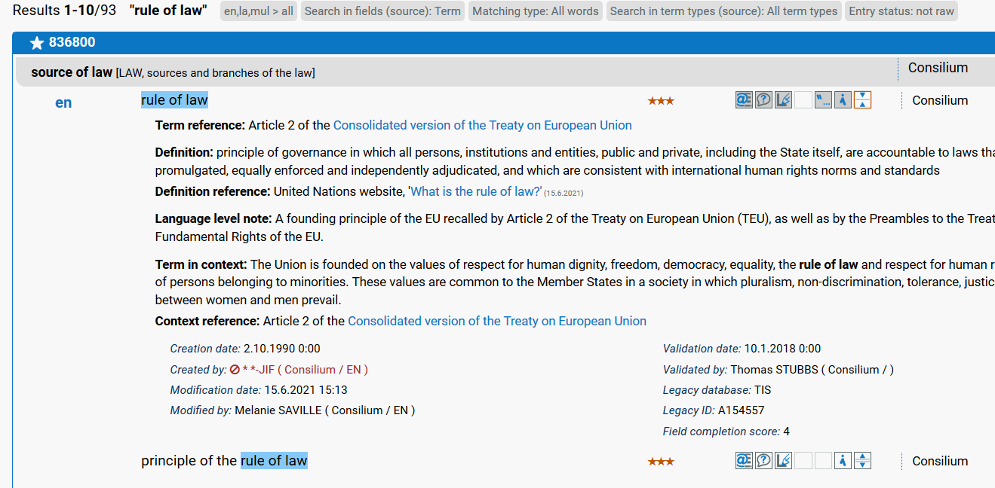
The New IATE – Search
Expand fields
from results page

Slide 21
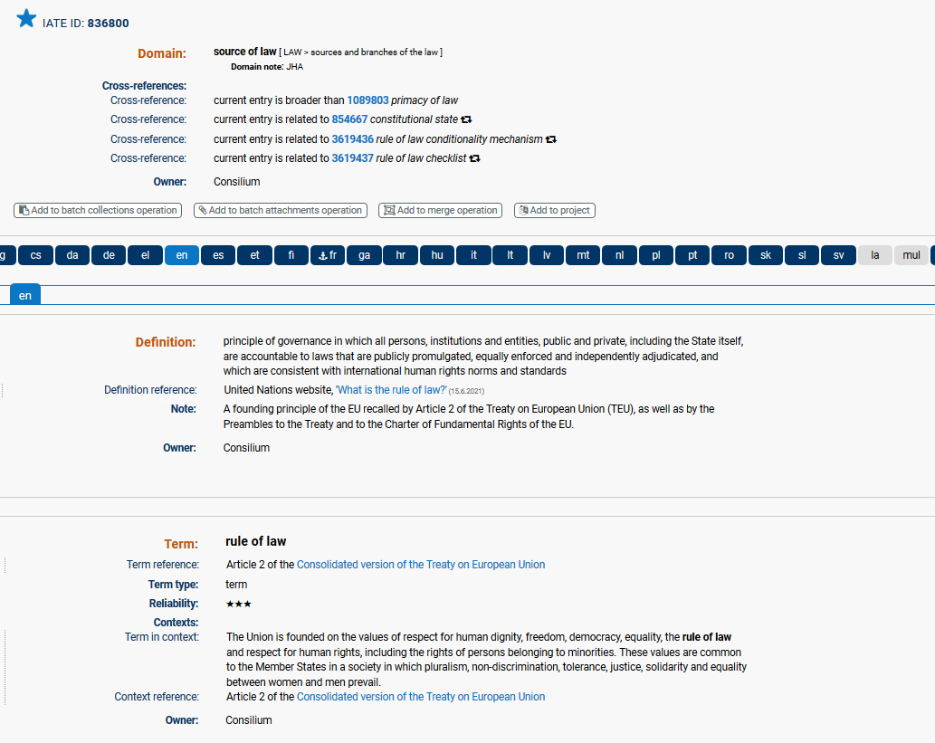
Full entry view
The New IATE – Search

Slide 22
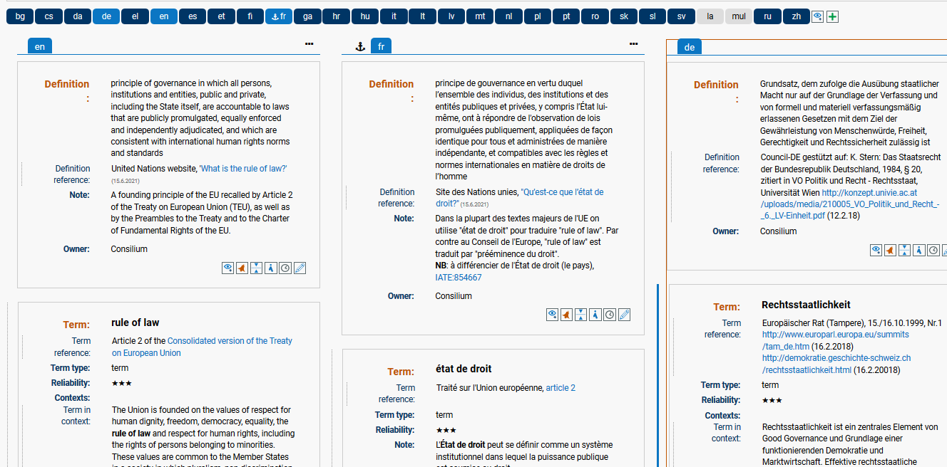
Full entry: trilingual view
The New IATE – Search

Slide 23
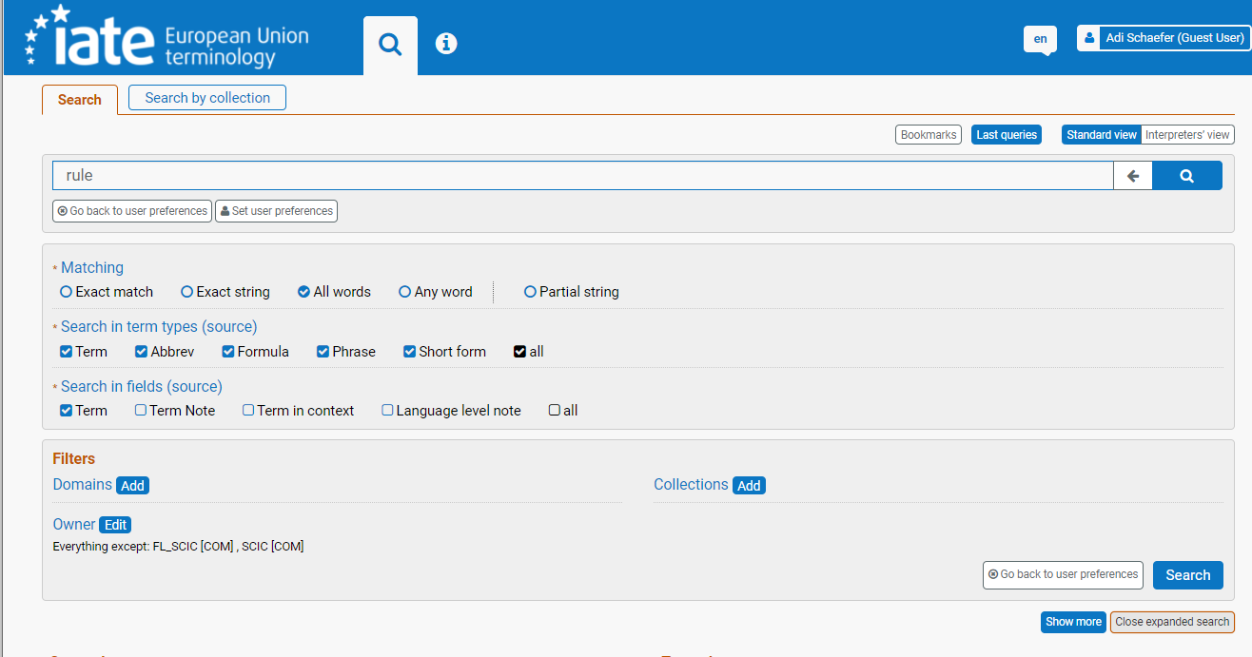
The New IATE – Search
153 hits
Expanded search:
filter by domain/ collection

Slide 24
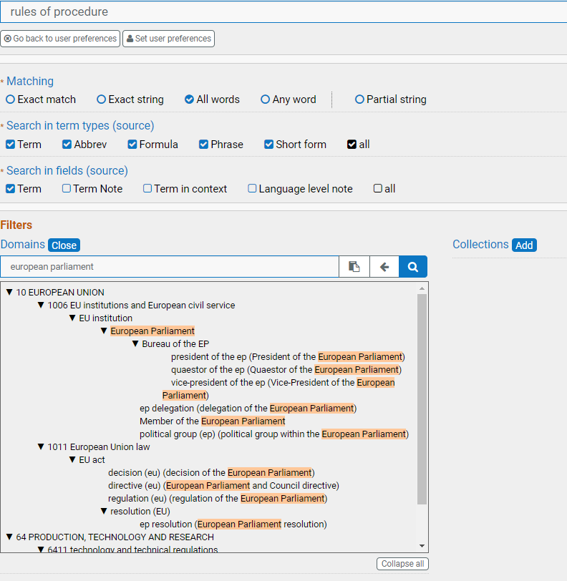
Filter by domain
The New IATE – Search

Slide 25
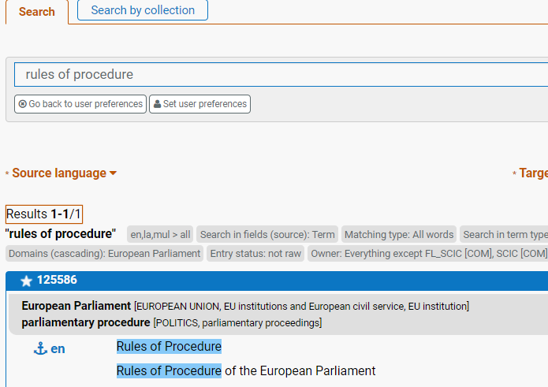
Filter by domain - results
The New IATE – Search
instead of 153

Slide 26
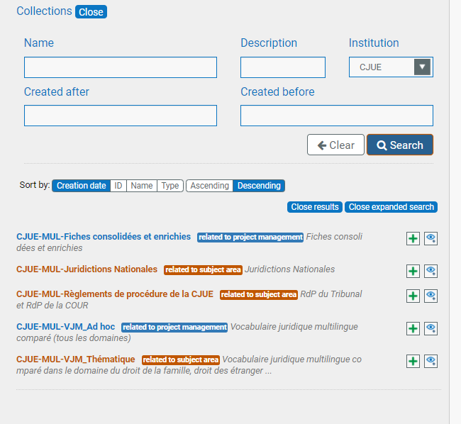
Filter by collection
The New IATE – Search

Slide 27
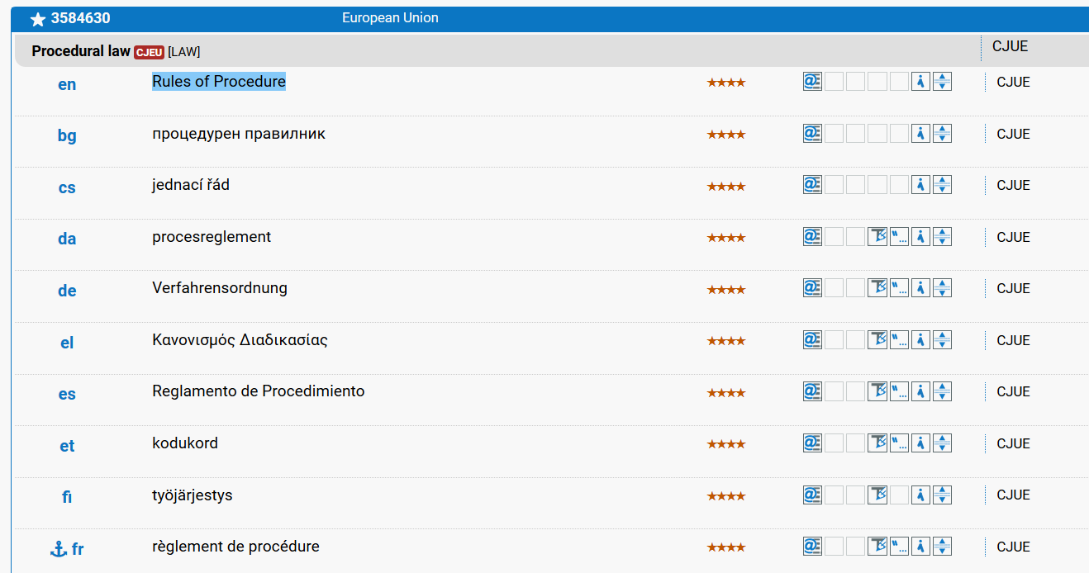
Filter by collection - results
The New IATE – Search

Slide 28
The New IATE – Search by collection

Slide 29
The New IATE – Search by collection
Example:
climate

Slide 30
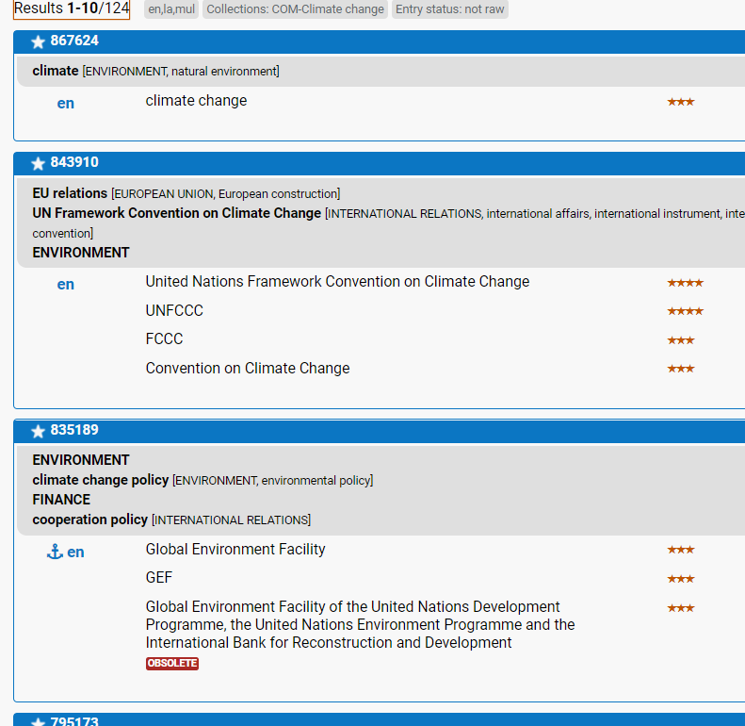
The New IATE – Search by collection
Example:
climate
in standard view

Slide 31
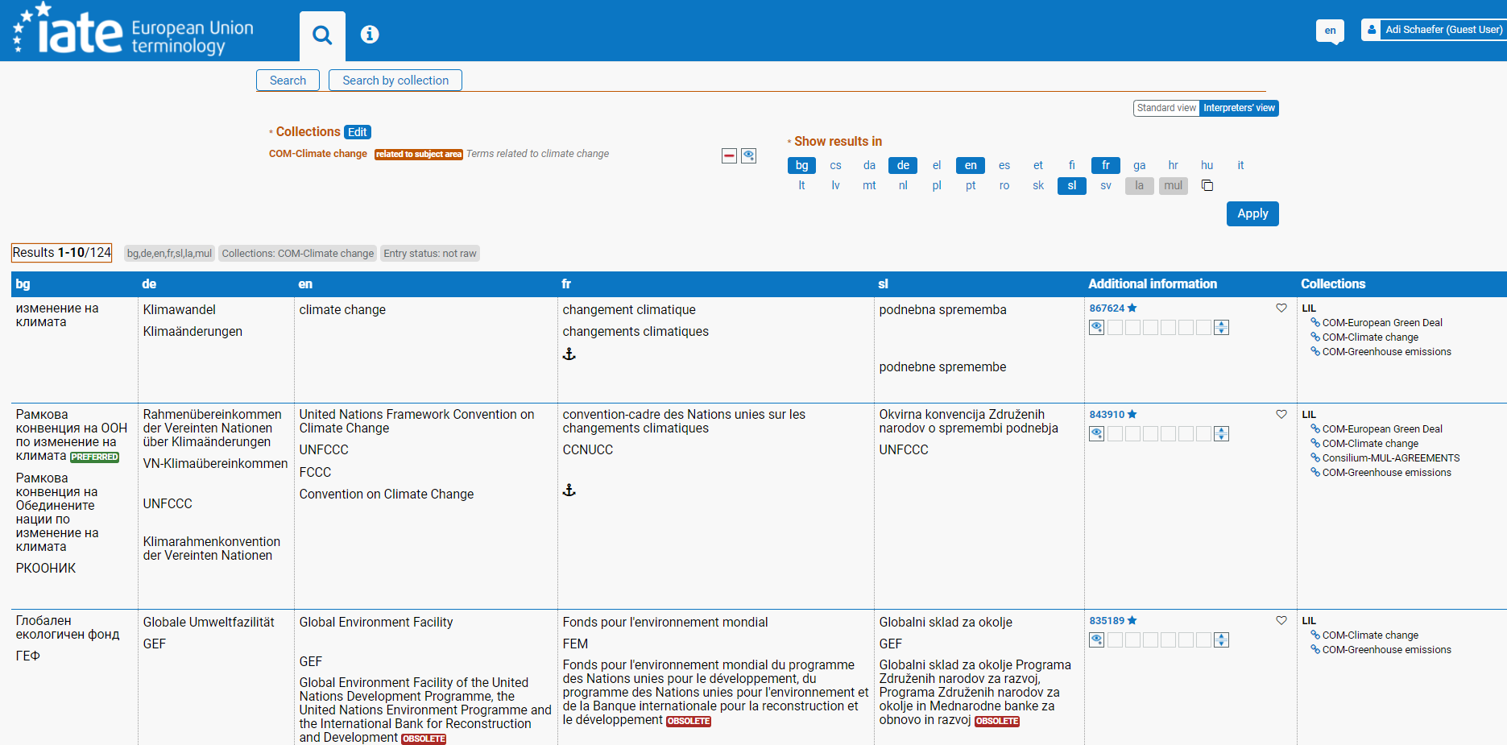
The New IATE – Search by collection
In interpreters’ view:

Slide 32
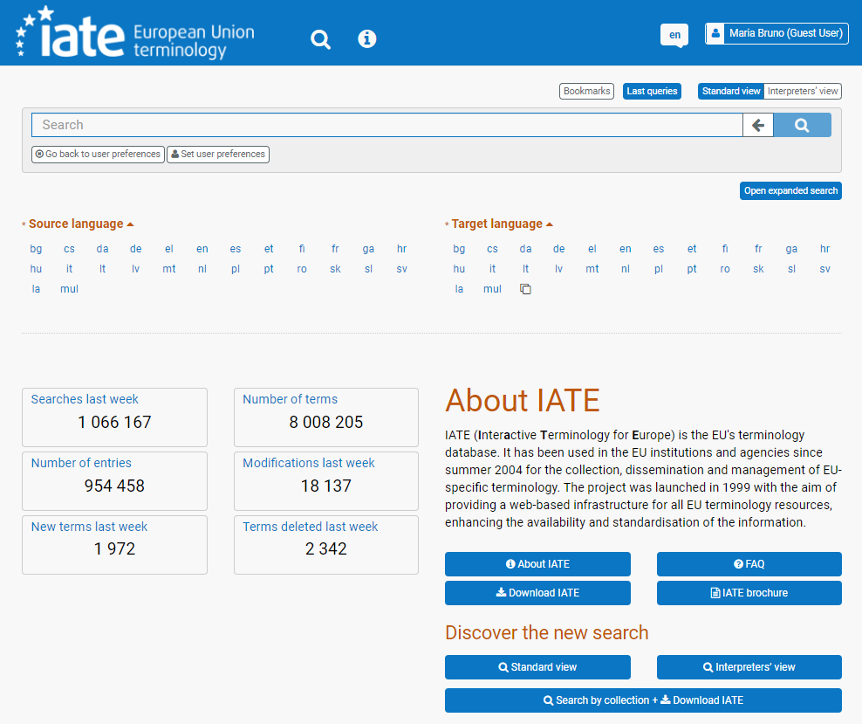
Creating termbases by downloading from IATE

Slide 33
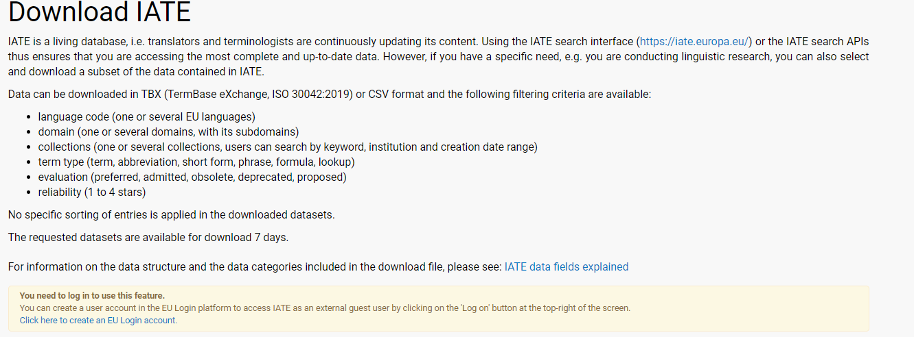
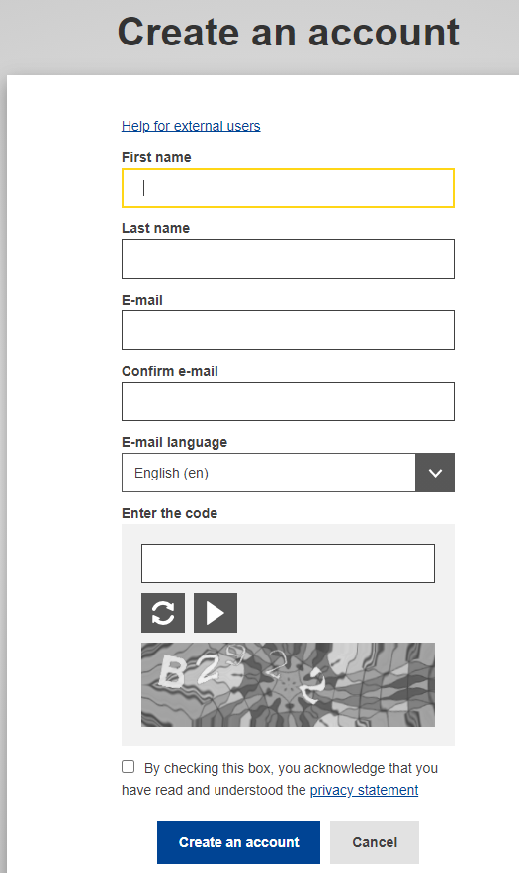
Creating termbases by downloading from IATE

Slide 34
Creating termbases by downloading from IATE
Example: termbase about digital operational resilience for the financial sector
Download
in Tbx or csv

Slide 35
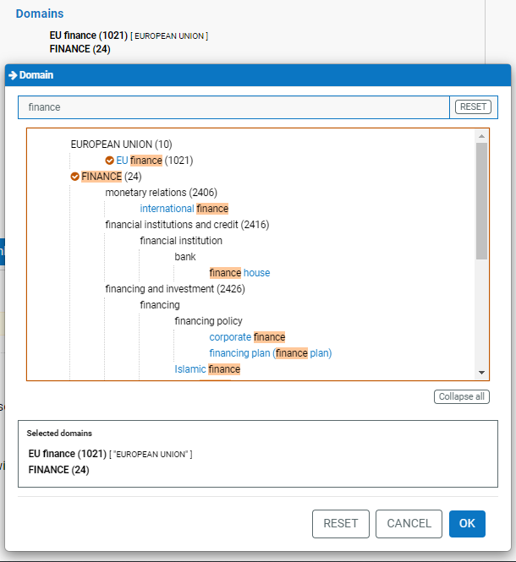
Filter by domain
Creating termbases by downloading from IATE
Click here
to add domains

Slide 36
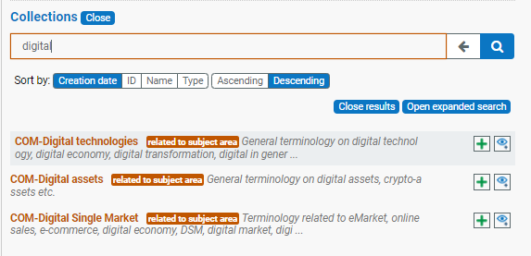
Filter by collection
Creating termbases by downloading from IATE
Search in the collections

Slide 37
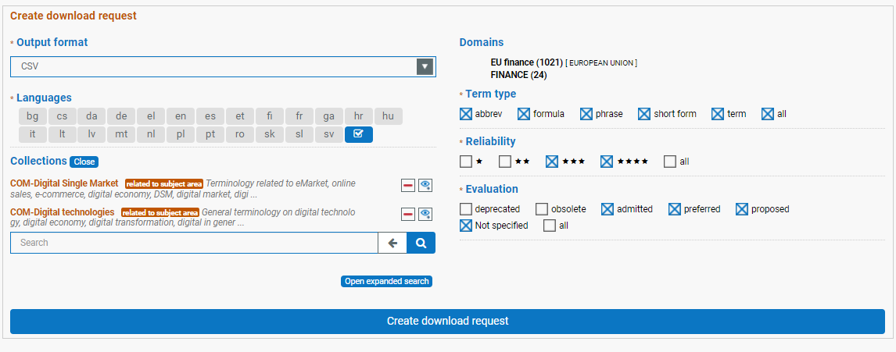
Creating termbases by downloading from IATE
Example: termbase about digital operational resilience for the financial sector

Slide 38
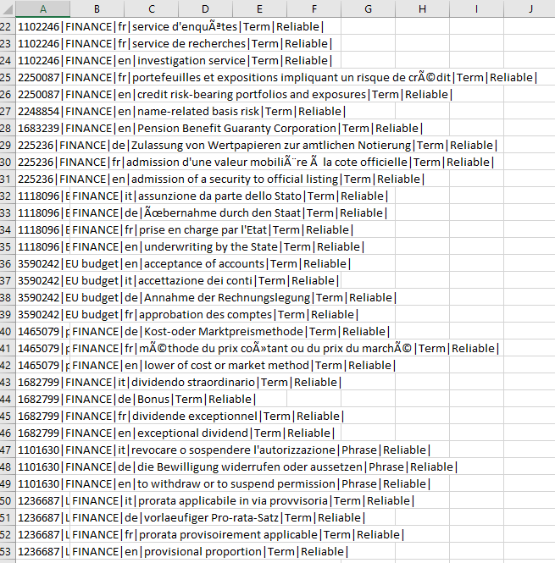
The termbase downloaded in CSV
Creating termbases by downloading from IATE
Example: termbase about digital operational resilience for the financial sector

Slide 39
Terminology Without Borders
New collaborations with universities
All the glossaries are available on our new website Yourterm.org
We have recently reached the goal of having 10 domains with our latest FIN project
36 subprojects
more than 20 partners
active collaborations on 3 continents (Europe, Asia and North America)

Slide 40
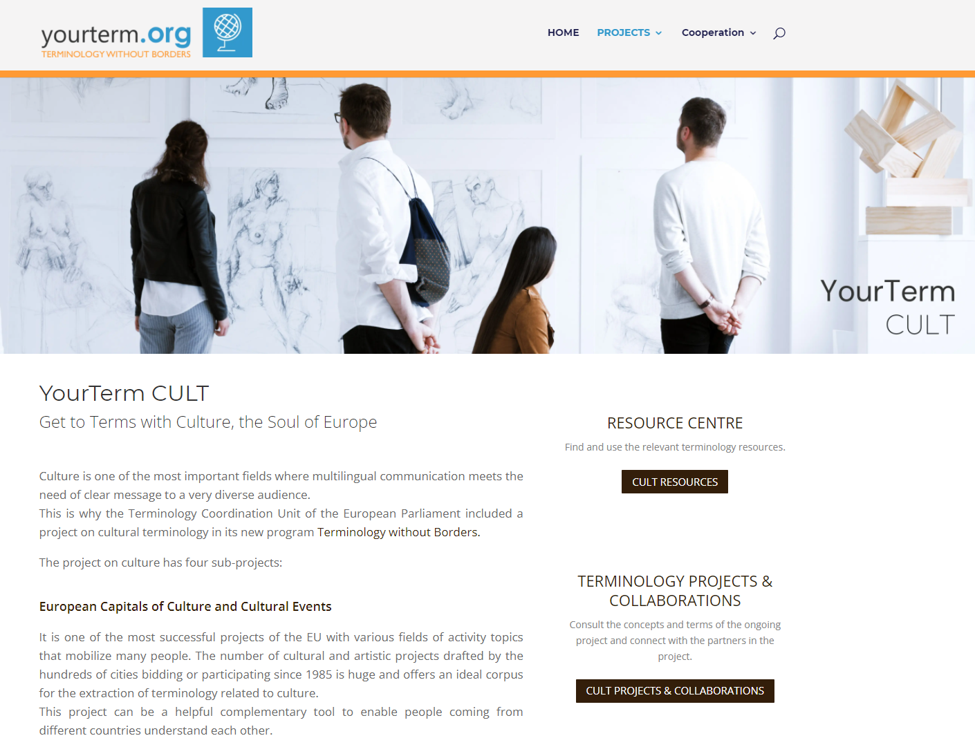
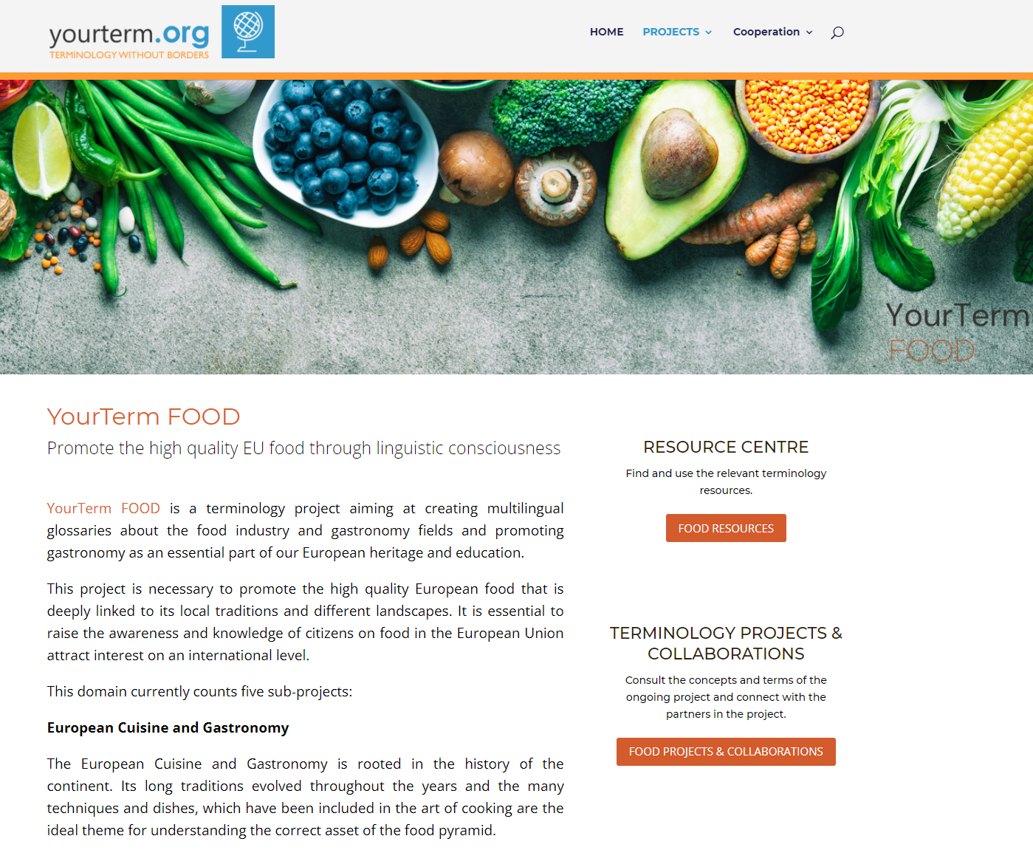
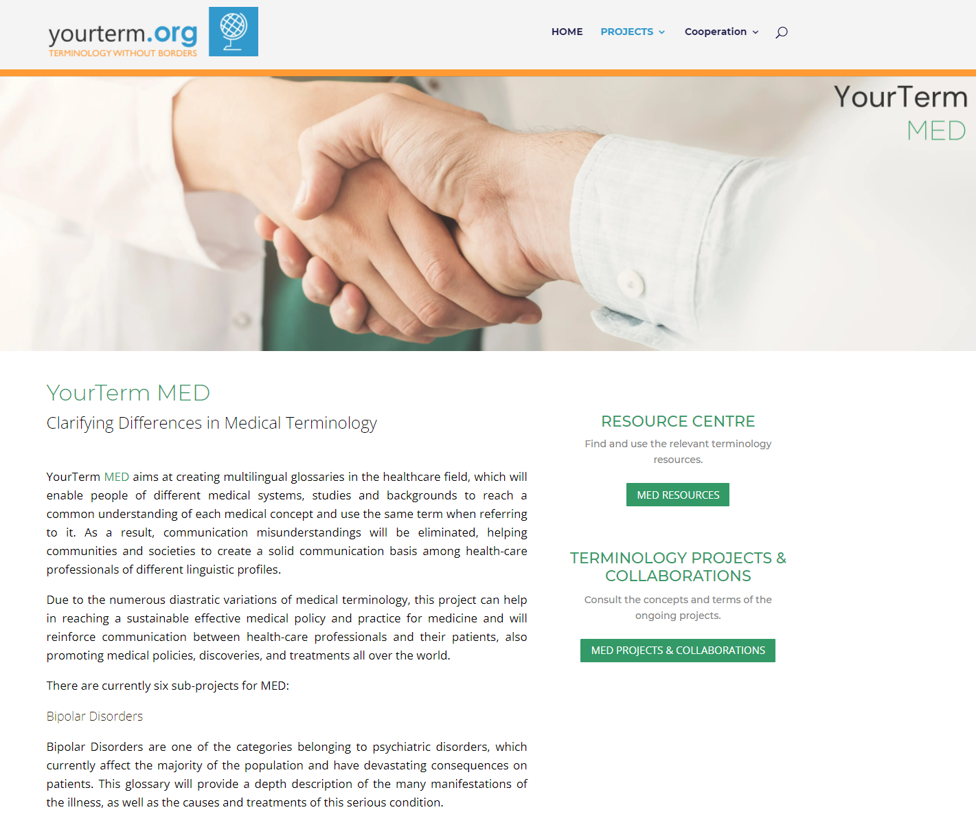
YourTermProjects

Slide 41
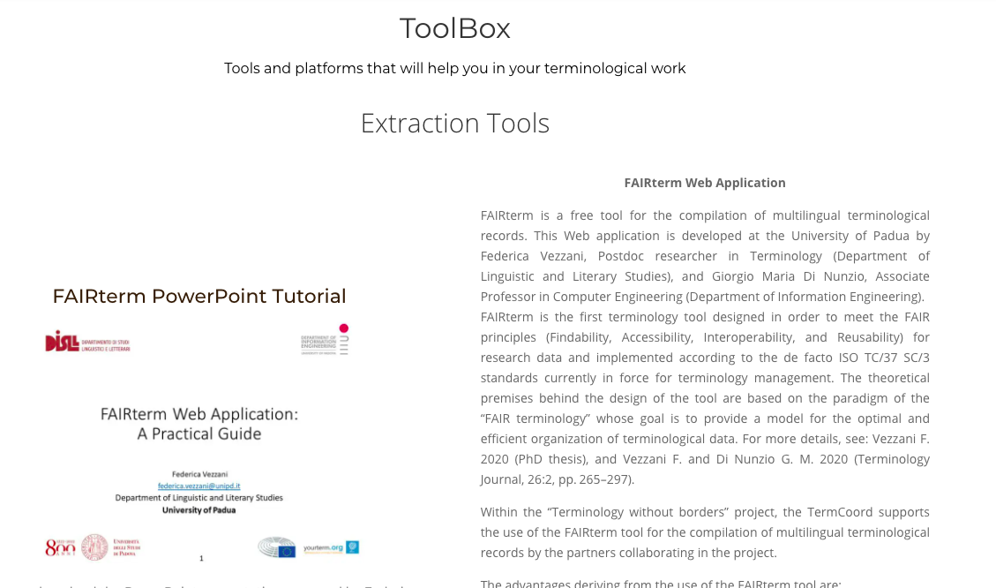
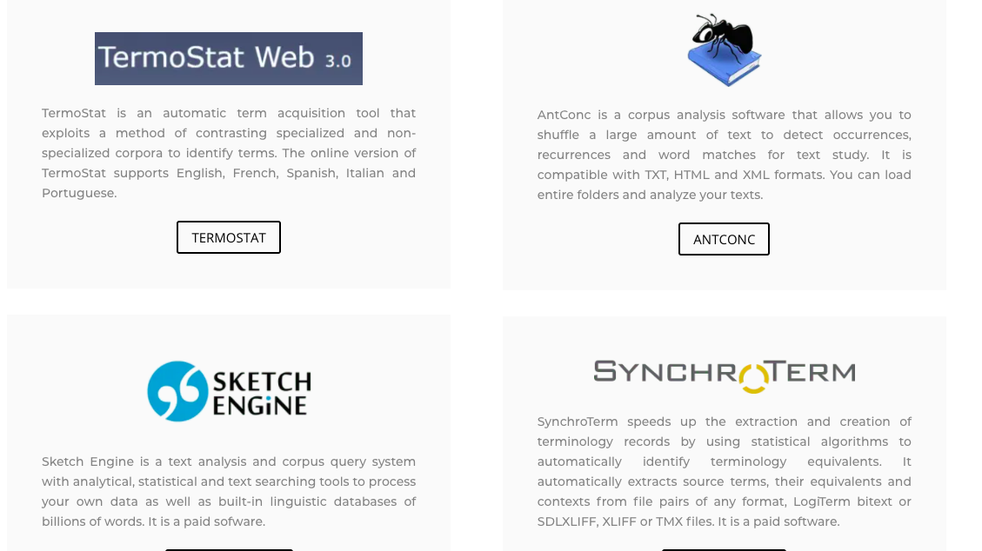
Toolbox

Slide 42
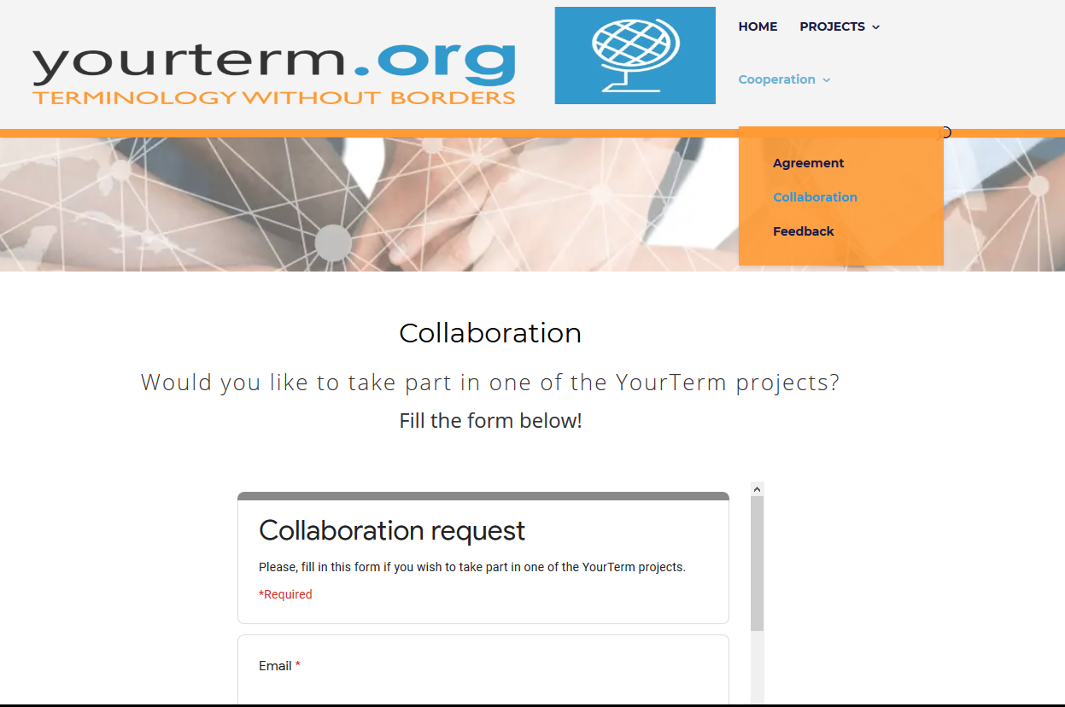
Collaboration request
Interested?
ALL languages are welcome!
Let’s do terminology together!!!
https://yourterm.org/collaboration/

Slide 43
Thank you!
DG TRAD Terminology Coordination
Send your question

